Slide 1
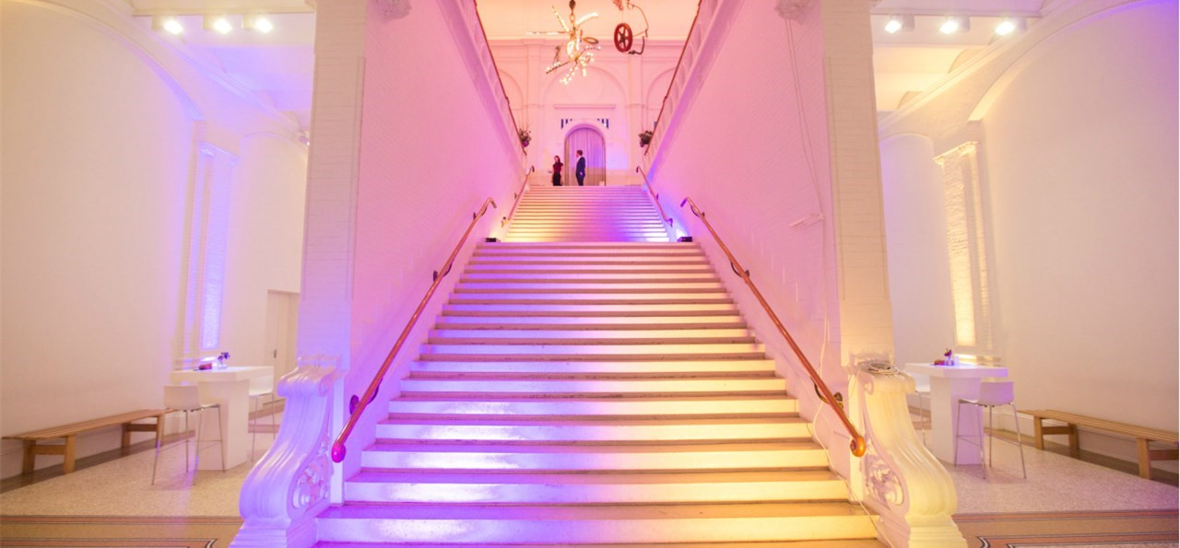
Dual MA Heritage and
Memory Studies
UvA Master’s Week – 2022/2023

Slide 2
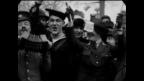
First World War Armistice Day, 11 November 1918
“at the eleventh hour on the eleventh day of the eleventh month”.

Slide 3
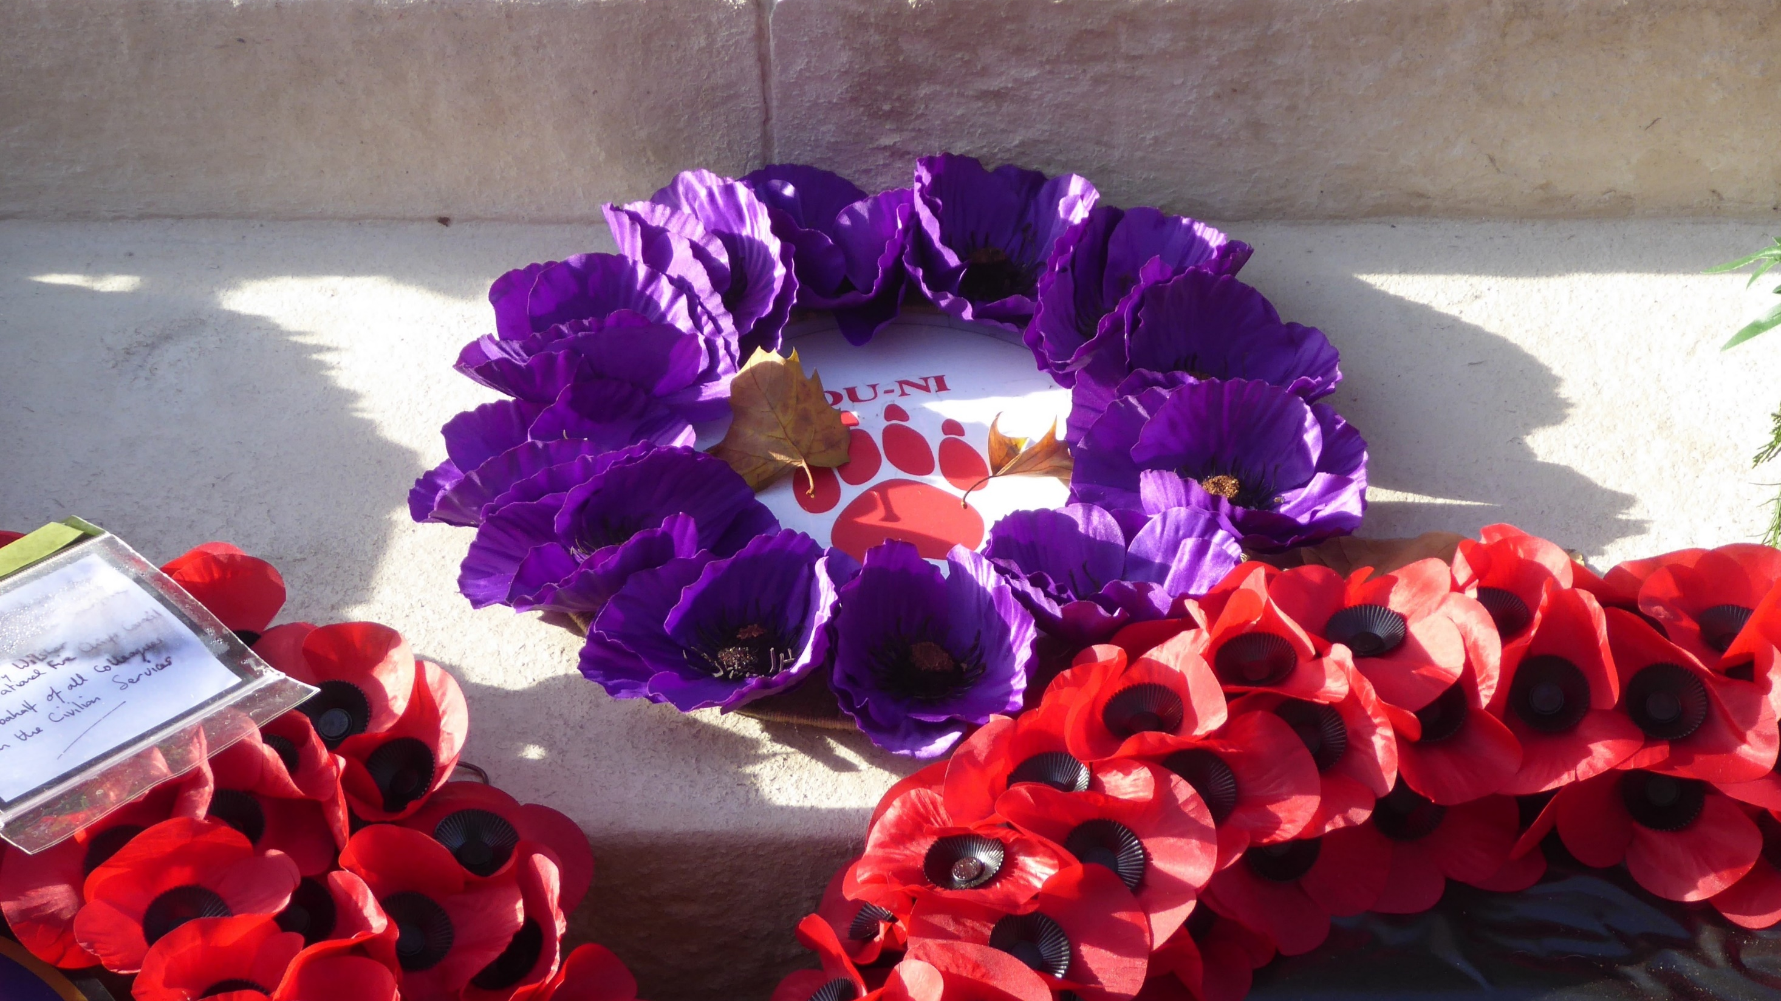
The purple poppy wreath to mark non-human animals involved in conflict, on the eastern side of the Cenotaph in Whitehall, London, 14 November 2018.
Photo: Ethan Doyle White (Wikimedia Commons)

Slide 4
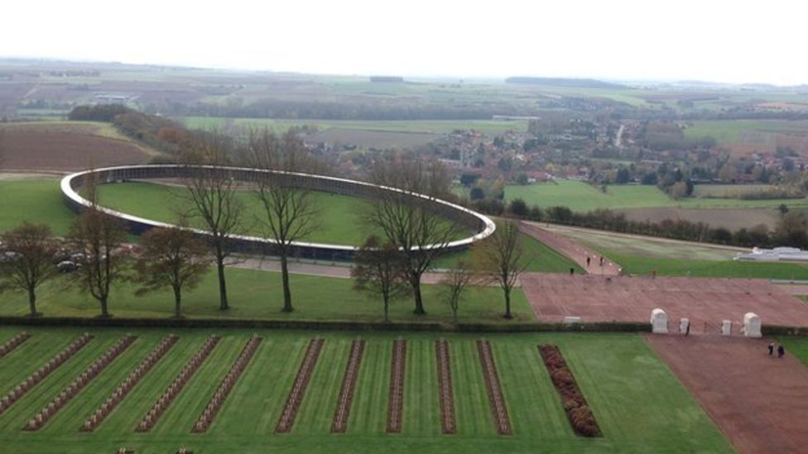
Ring of Remembrance memorial at Notre-Dame-de-Lorette, France (inaugurated in 2014)

Slide 5
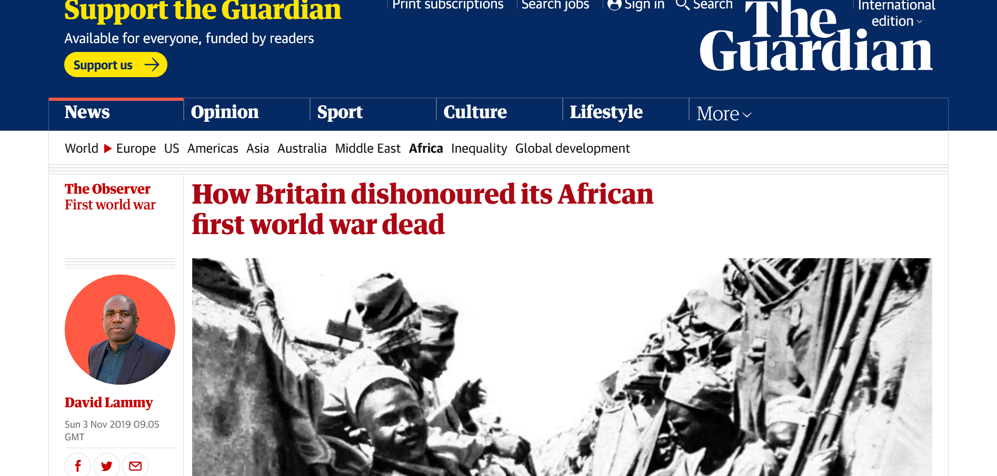
https://www.theguardian.com/world/2019/nov/03/how-britain-dishonoured-first-world-war-african-dead

Slide 6
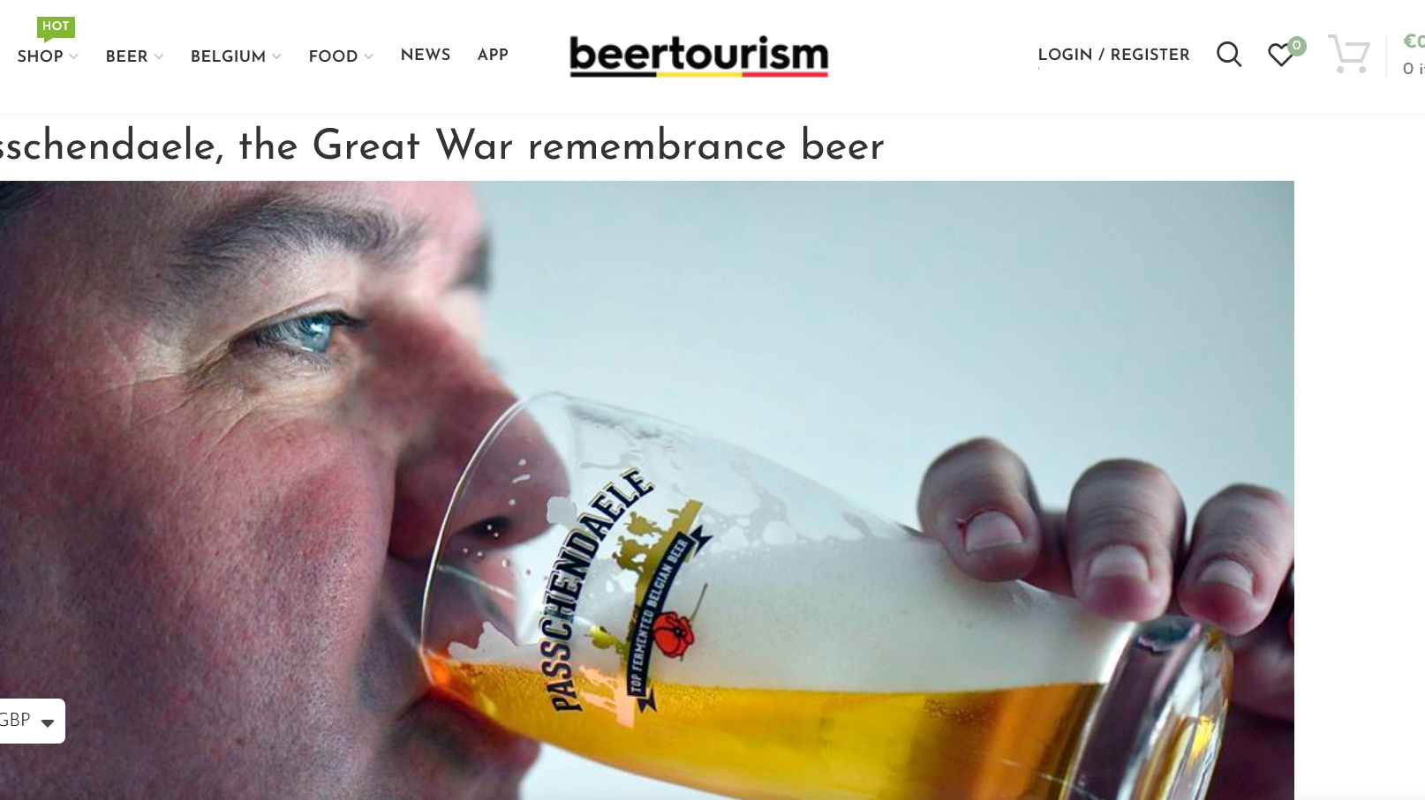

Slide 7
“[…] the present selects an inheritance from an imagined past for current use and decides what should be passed on to an imagined future.”
John E. Tunbridge and Gregory Ashworth, Dissonant heritage: the management of the past as a resource in conflict (Chichester, UK: John Wiley & Sons, 1996) p. 6.

Slide 8
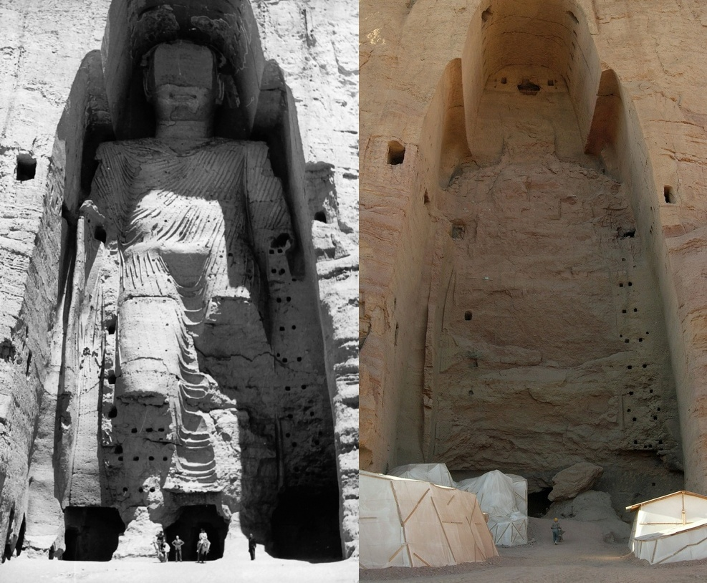
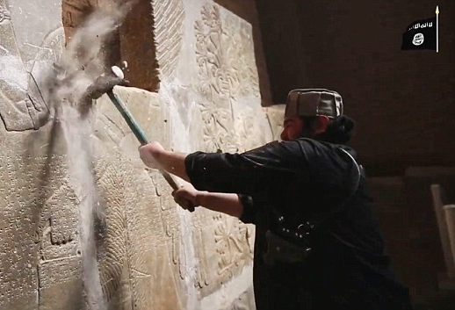
UNESCO/A Lezine

Slide 9
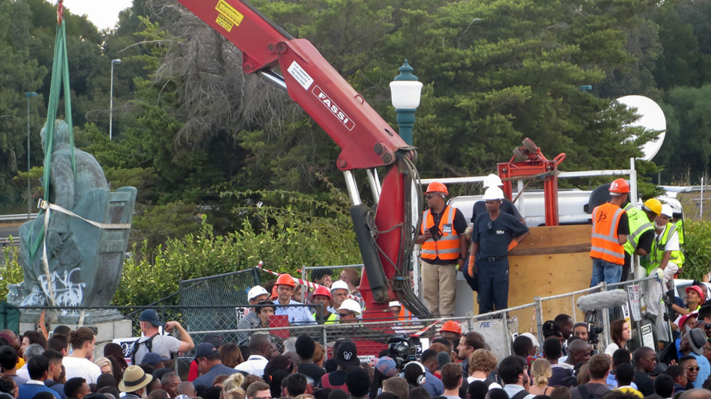
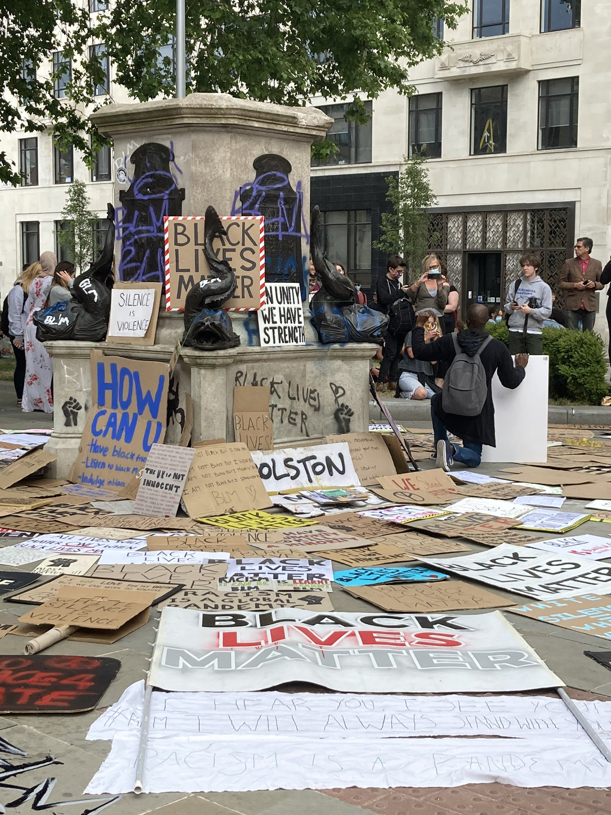
Tony Carr, https://commons.wikimedia.org/wiki/File:Goodbye_Cecil_John_Rhodes20_(16481463023).jpg
Caitlin Hobbs, https://commons.wikimedia.org/wiki/File:Edward_Colston_-_empty_pedestal.jpg

Slide 10
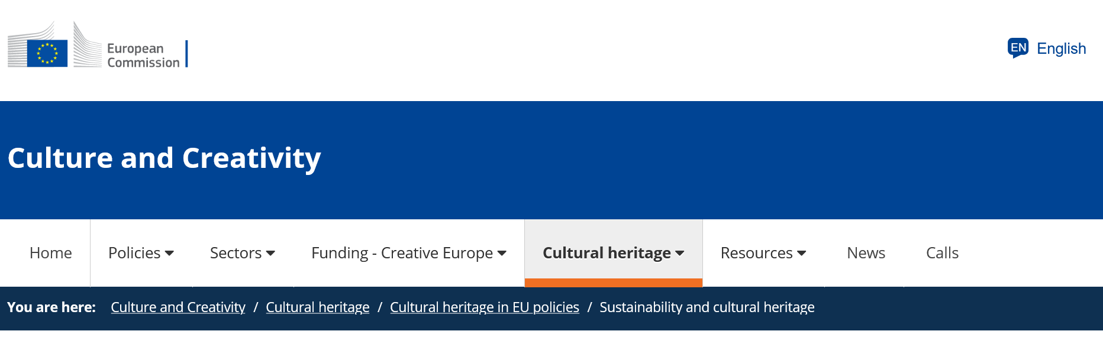
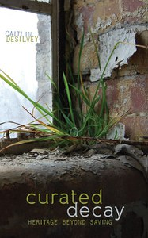

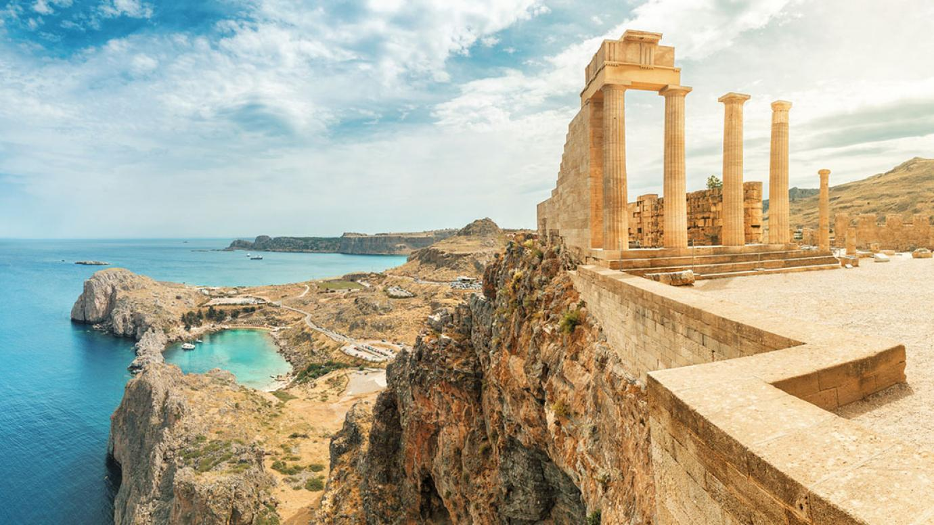
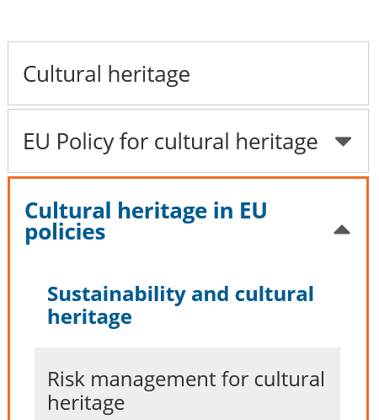
Focus on sustainability and resilience
But how about curated ruination and creative collapse?

Slide 11
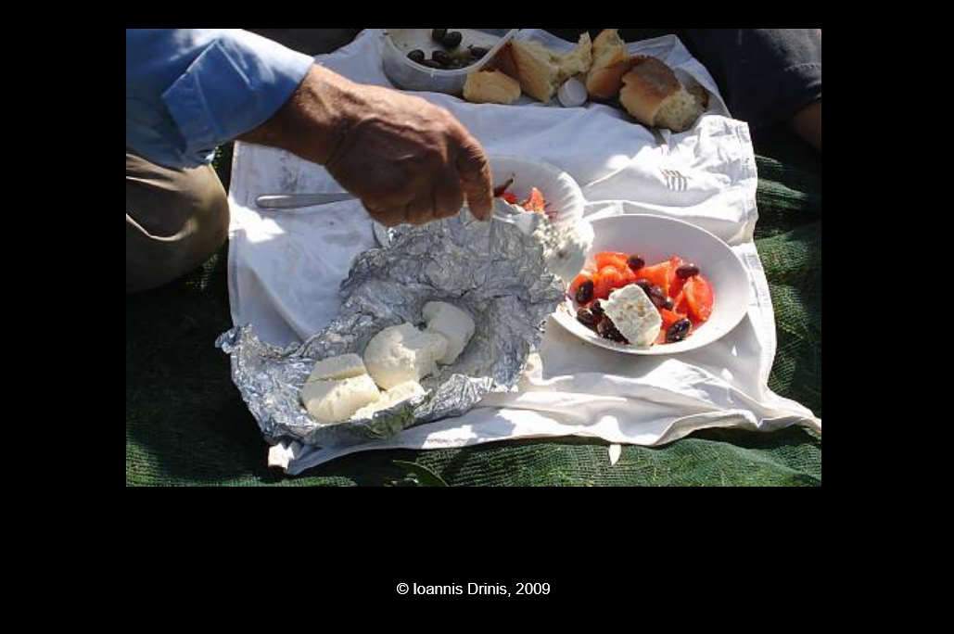

Slide 12
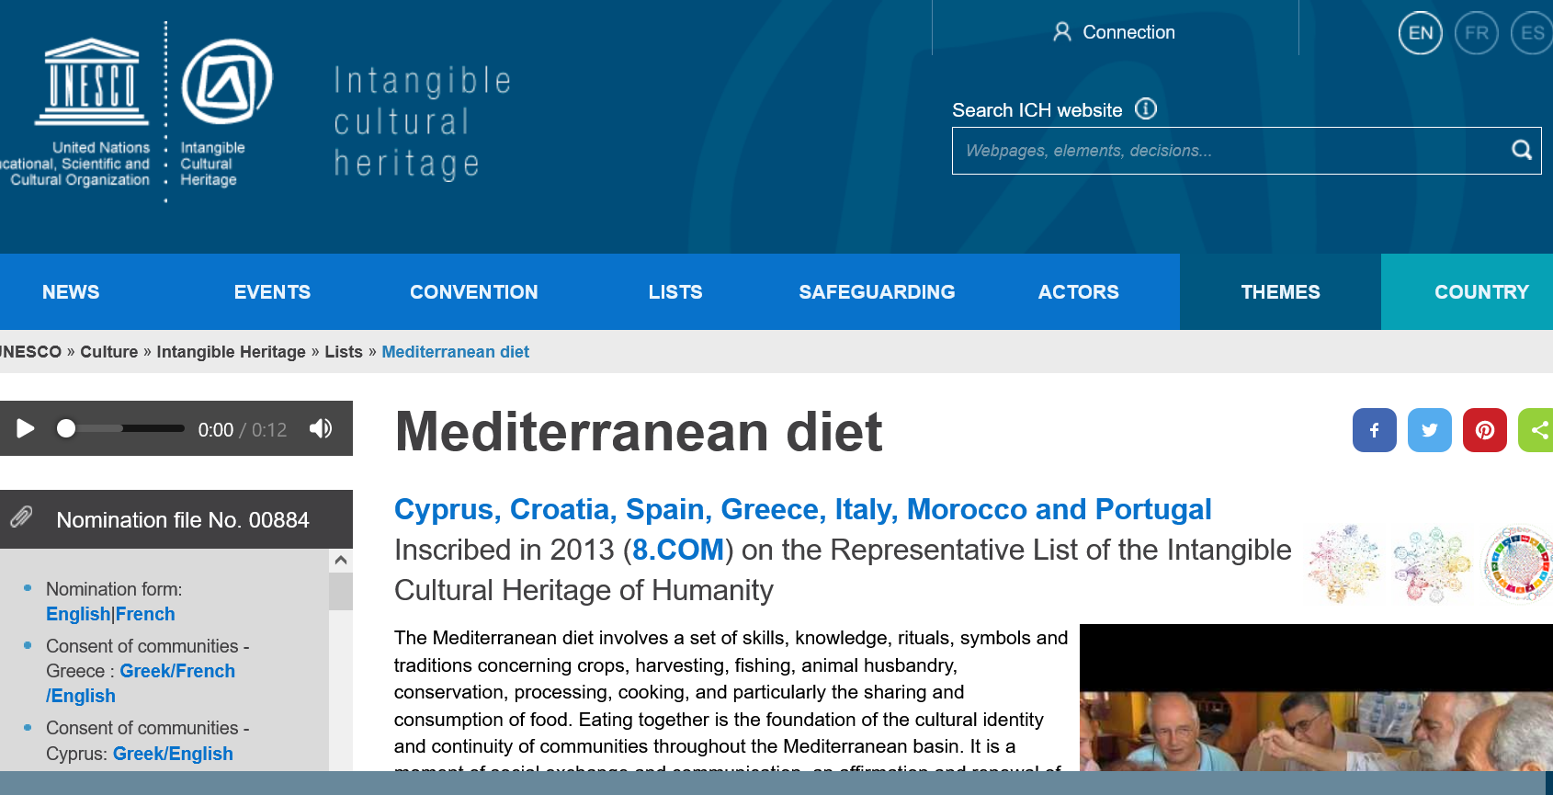

Slide 13


Theory and practice: an integrated approach

Slide 14
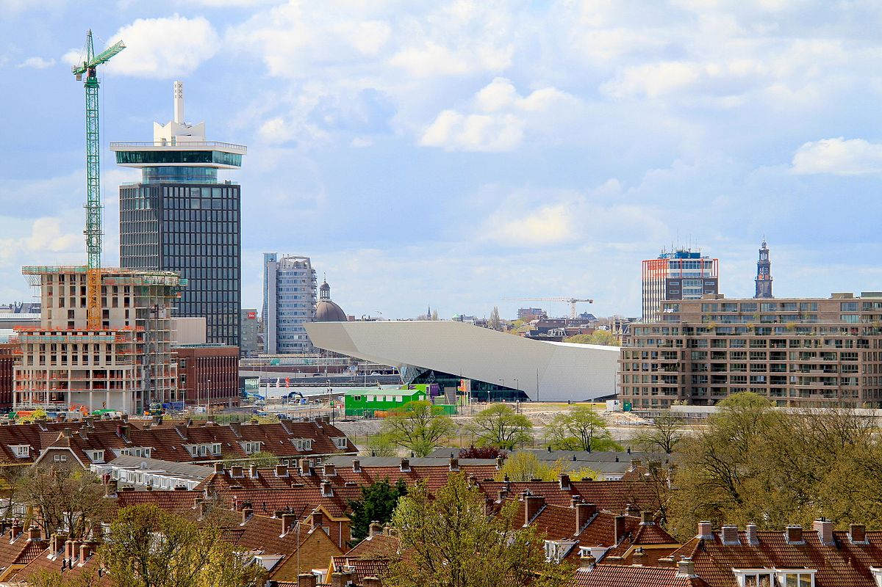
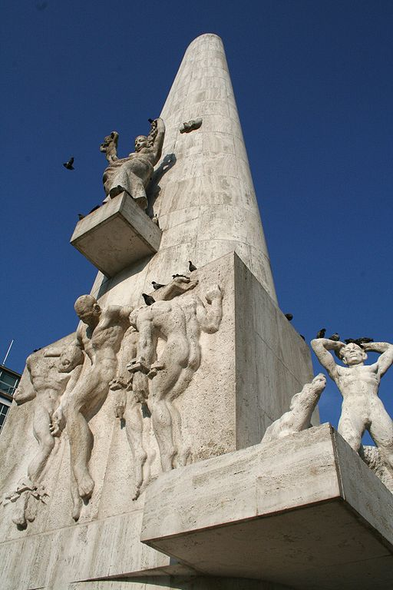
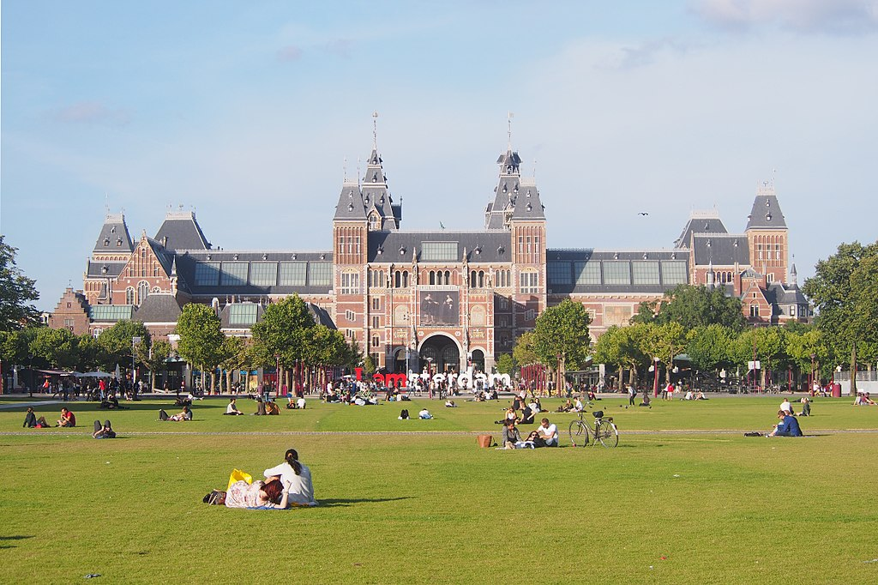
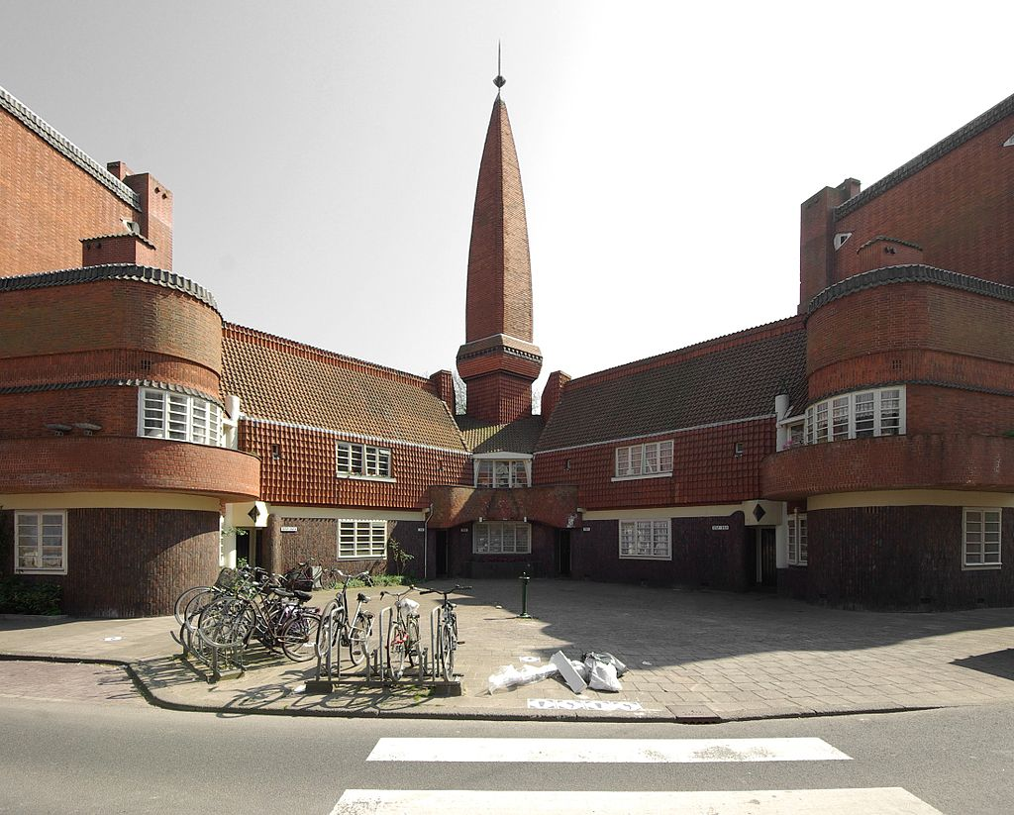
Amsterdam: an ideal laboratory to study heritage and memory
The Rijksmuseum
ADAM Tower, Eye, Amsterdam-Noord – photo: Thomas van Mens
The National War Monument on Dam Square
Het Schip Museum – photo: Janericloebe

Slide 15
Course programme (90 EC)
FIRST YEAR Semester 1 | FIRST YEAR Semester 2 | SECOND YEAR Semester 1
Block 1 Heritage and Memory Theory (6 EC) Elective (6 EC) | Block 1-3 Internship (30 EC) Accompanied by an Internship Seminar OR: Courses at the UNIVERSITY OF BOLOGNA (combined with an internship of 18 EC) | Block 1 Thesis Seminar (6 EC) Current Issues: Excursion Abroad (6 EC)
Block 2 and 3 Who Owns the Past? (12 EC) Elective (6 EC) |  | Block 2 and 3 Master’s thesis (18 EC)

Slide 16
Electives
Examples from 2021-2022:
Archaeology, matter and materiality
Archaeology, museums and the public
Archiving Art
Biography of landscape
Crisis and alternative languages in literature and art: Greece, the Mediterranean and beyond
Cultural Memory and Trauma
Enlargement and external relations of the EU
How literature shapes society
Religion and spirituality in contemporary societies
Transformations in Modern Middle-Eastern History
The power of words, objects and rituals
See: https://studiegids.uva.nl/xmlpages/page/2021-2022-en/search-course

Slide 17
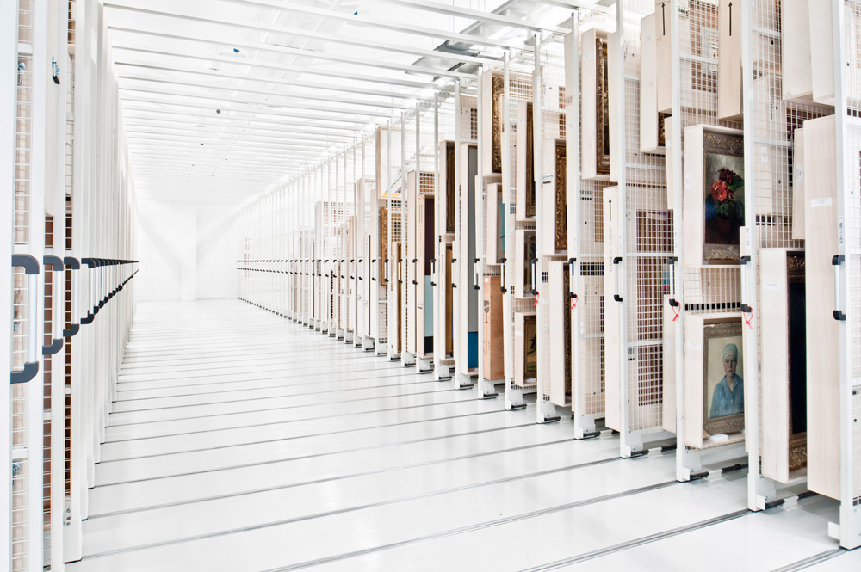
Internships
Embedded in the academic programme, with high-quality supervision
Extended length (30 ECTS)

Slide 18
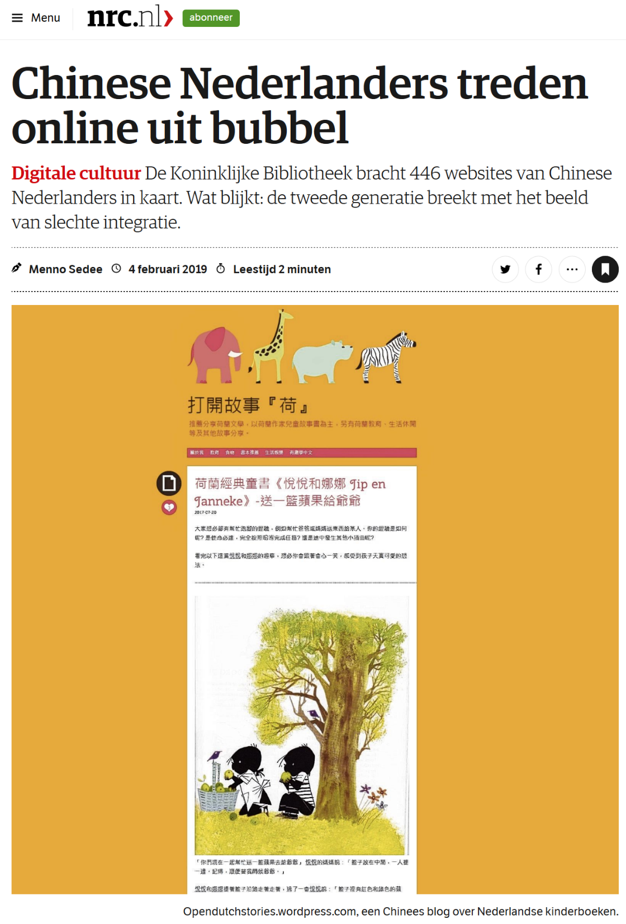
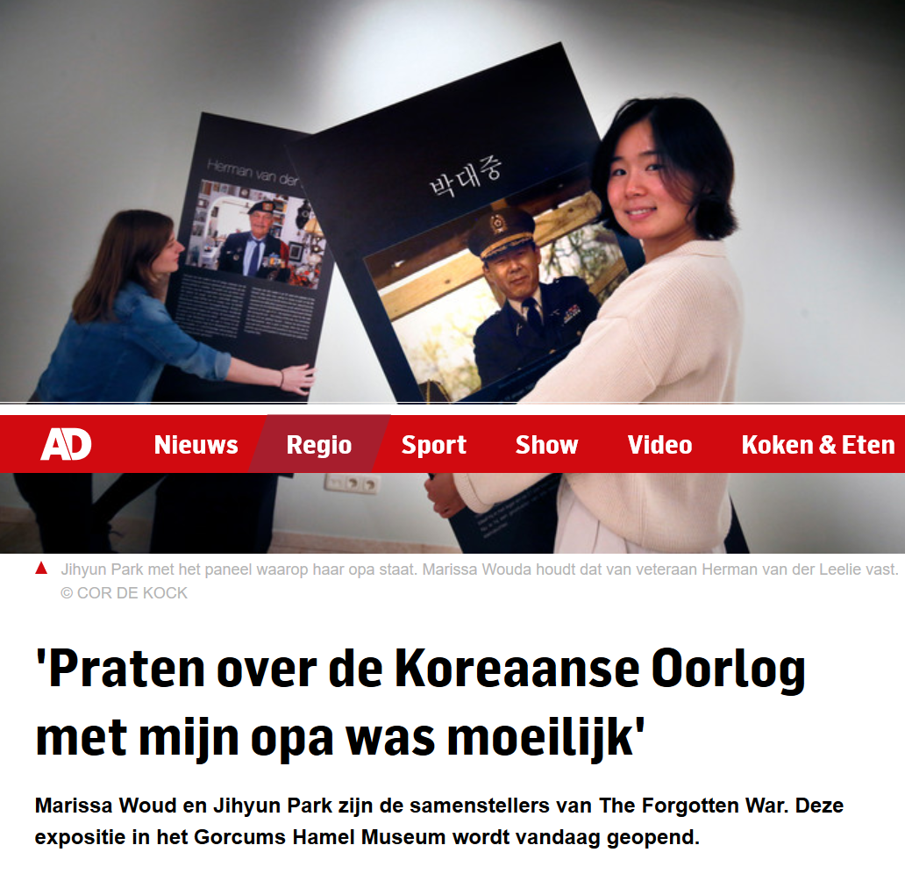

Slide 19
Internship organisations
Amsterdam Museum
ARCAM, Amsterdam
Artis Library, Amsterdam
Centraal Museum, Utrecht
Embassy of the Netherlands, Berlin and New York
Erfgoedhuis Zuid-Holland, Delft
Erfgoedvereniging Heemschut, Amsterdam
The European Observatory on Memories, Barcelona
Former Concentration Camp Vught
Imagine IC, Amsterdam
Istanbul Archaeological Museum
Jewish Historical Museum, Amsterdam
Kasteel Amerongen
Kasteel de Keukenhof
Koninklijke Bibliotheek (National Library), The Hague
Meertens Instituut, Amsterdam
MediaLAB Amsterdam
MOOI Noord Holland
Netherlands Cultural Heritage Agency, Amersfoort
Museo della Liberazione, Rome
Openluchtmuseum, Arnhem
Rijksmuseum, Amsterdam
Ruimtelijke Ordening, Amsterdam (local government)
Smithsonian Museum, Washington
Stadsdeel Centrum Amsterdam (local government)
Stichting Natuurmonumenten (nature conservation)
Stichting Stadsherstel, Amsterdam
Teylers Museum, Haarlem
Tropenmuseum, Amsterdam
UNESCO Amsterdam, Paris and The Hague
Various ministries in The Hague (national government)
Verzetsmuseum (Resistance Museum), Amsterdam
Waag Amsterdam
The list continues to grow…

Slide 20
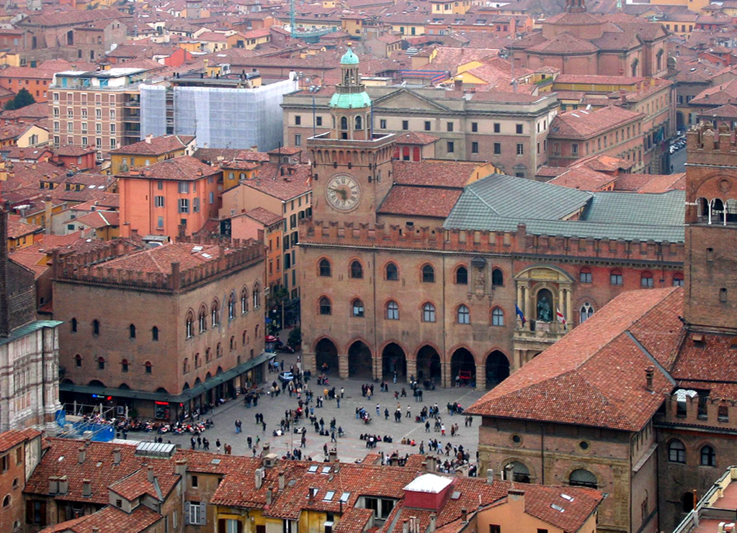

Bologna Exchange

Slide 21
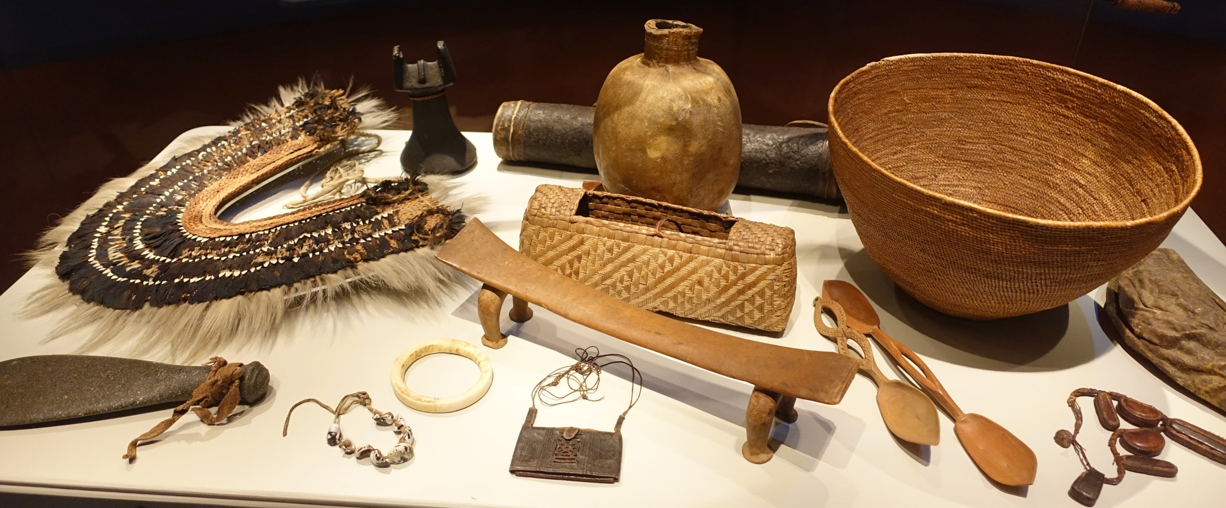
New specialization: Restitution Research (in Dutch)

Slide 22
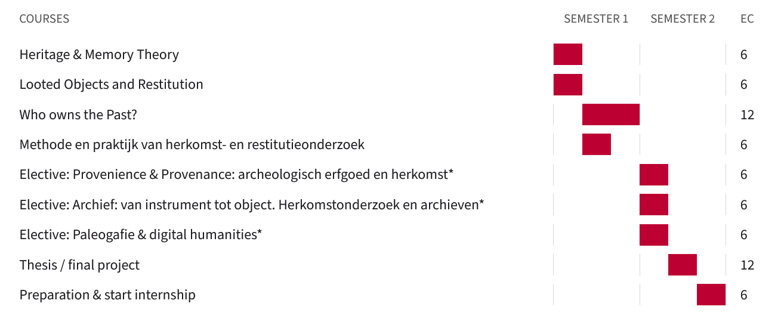
Programme Year 1

Slide 23
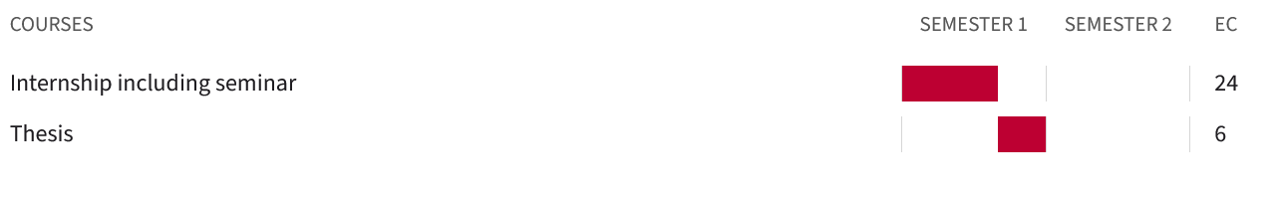
Programme Year 2
Please note: passive knowledge of Dutch is necessary for this specialisation, since archival material will be in that language. The Expert Centre Restitution of the NIOD (the Institute for War, Holocaust and Genocide Studies) is partner in this programme, as are a number of museums that offer internships for this particular specialisation.

Slide 24
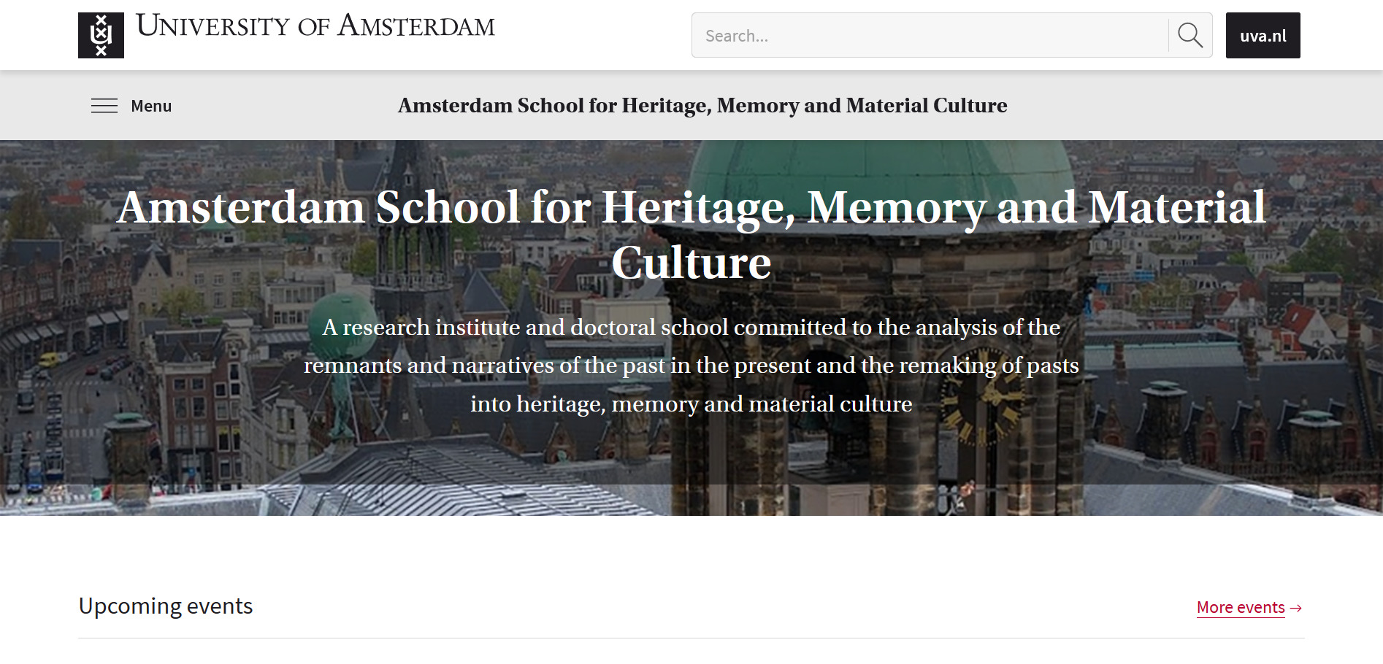
Close ties with academic research

Slide 25
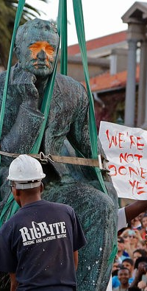
What is special about Heritage and Memory Studies?
Combination of heritage and memory
Not focussed on museums but analysing the broader field of cultural and natural heritage
Preparing heritage professionals capable of critical academic thinking and with a holistic, strategic vision

Slide 26
Career prospects
Research/policy-related or project-management positions
in areas such as:
preservation and presentation of listed buildings
presentation of cultural heritage in museums
cultural departments within governments
maintenance and development of cultural landscapes
adaptive re-use industrial heritage or urban heritage
media and communications
cultural tourism

Slide 27
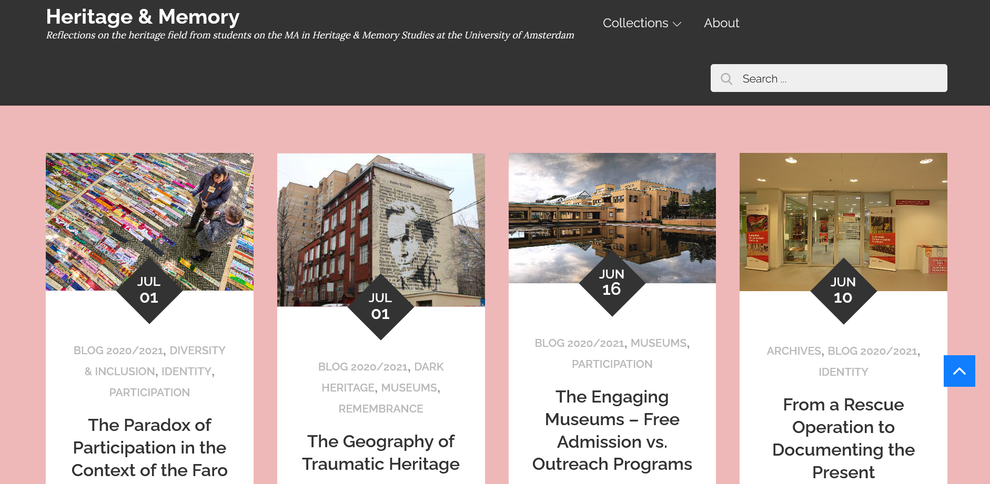
https://heritageandmemorystudies.humanities.uva.nl

Slide 28
MEET THE STUDENTS
Meet Emilie Tesch and Lennart de Bakker, two second-year students who will tell you more about the programme and their experiences as an intern.

Slide 29
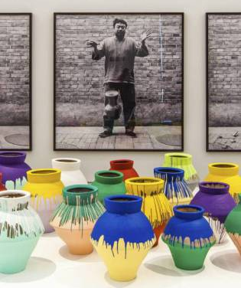
Thank you for your attention!
For more information about the programme:
Tamara van Kessel
t.m.c.vankessel@uva.nl
For specific questions about application and admissions:
AdmissionsMA-fgw@uva.nl

Slide 30
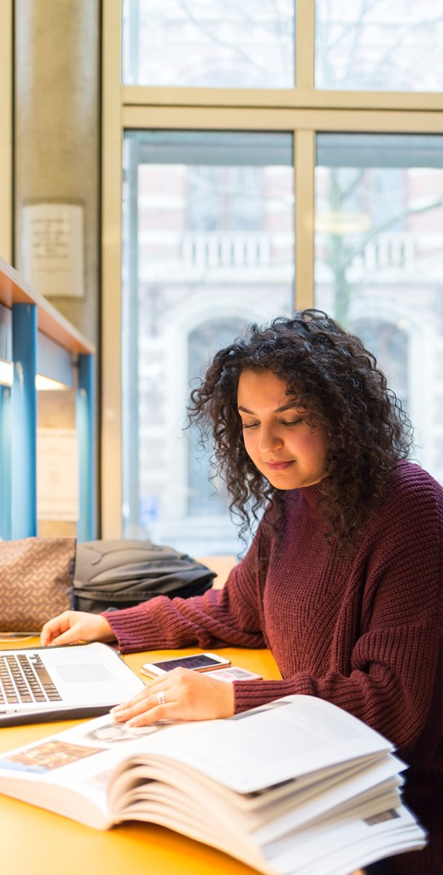
Admissions
Deadline for selective programmes
1 March 2022
Entry requirements:
A Bachelor’s degree from the UvA or from another accredited university, in:
  => the fields of cultural anthropology, cultural studies, (art) history, archaeology and prehistory, social geography, or urban planning;
  => the humanities or social sciences with a minimum of 30 ECTS (equivalent to a full-time semester of academic studies) taken in the field of heritage and memory studies.
GPA of at least 7.5
Sufficient proficiency in English
Specific questions about application and admission
Email: AdmissionsMA-fgw@uva.nl

