Slide 1

Communication and Information Studies
13 February, 16.00-17.00h
UvA Master’s Week 2023
Program director:
Dr. Corina Andone
C.Andone@uva.nl
Also online:
Julia Gomes, alumna

Slide 2



What is communication and information studies about?
The programme provides students with a solid theoretical and methodological foundation for understanding the way in which language is used for informative and persuasive purposes.
politics
health
science
Students are trained in analysing and evaluating the discourse in these communicative practices by using insights from discourse analysis, argumentation theory, rhetoric, genre theory and stylistics.

Slide 3

Theory and practice
Communication and Information Studies:
is a 1.5 year professional master programme
two parts:
  (a) one academic year of courses
  (b) one semester consisting of an internship in a professional organisation.

Slide 4

Study scheme
The academic year = two semesters of three periods each.
  Block 1 and 2 of each semester are "lecture periods"
  Block 3 is an "individually-oriented work period".
  Lecture periods consist of six weeks of classes followed by an exam week; individual work periods are four weeks long.
ECTS, the European Credit Transfer System
  1 EC = 28 hours of work.
  30 EC per semester = about 40 hours per week

Slide 5
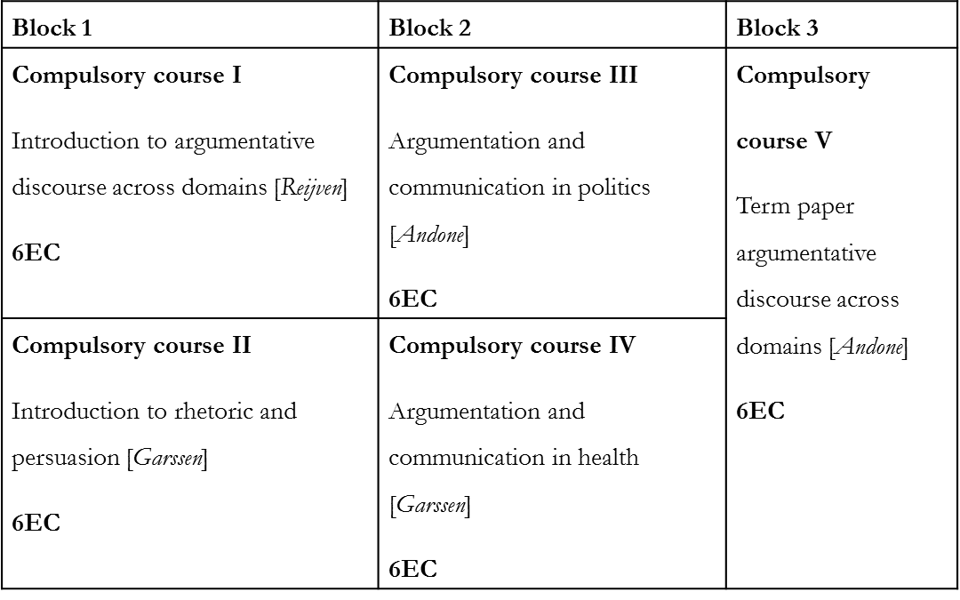
Study scheme
Year 1, Semester 1

Slide 6
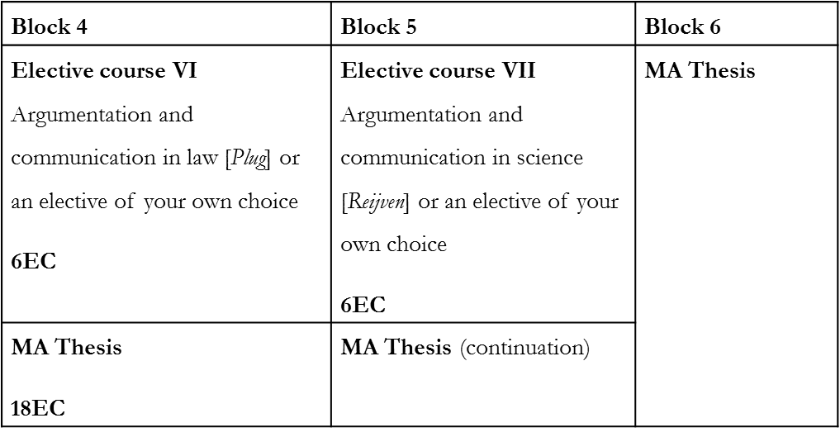
Study scheme
Year 1, Semester 2

Slide 7
Study scheme
Year 2, Semester 1
Block 1 | Block 2 | Block 3
Internship 30EC

Slide 8
Examples of course descriptions
I. Introduction to Argumentative Discourse across Domains
This course provides the theoretical and empirical insights that are needed in order to study the use of argumentation in various communicative domains. Apart from a general introduction to argumentation theory and genre theory, the course provides the basic tools required for the analysis and evaluation of argumentative discourse.
II. Introduction to rhetoric and persuasion
This course gives an introduction into theories of effective language use from antiquity to modern times. The following topics are dealt with: ancient and modern theories of rhetoric, rhetorical analysis, strategic maneuvering.
III. Argumentation and Communication in Politics
The course provides a systematic overview of the main discursive approaches to political interviews, election debates, parliamentary debates, political speeches, social media and policymaking. The course guides students into applying the theoretical insights in an original analysis and evaluation of political communicative practices under the form of a research paper.
IV. Argumentation and Communication in Health
In this course the argumentative and stylistic properties of the medical consultation, the health brochure and the consumer medicine advertisement will be investigated. The aim of the course is to establish how the institutional context affects the type and structure of the argumentation as well as the verbal presentation of the information and argumentation.

Slide 9

Examples of theses
A strategic maneuvering analysis of corporate image repair responses on Twitter in the era of “cancel culture”
Corporate Response Strategy during Greenwashing Crisis: a case study of Image/Brand Trusts Repair strategies
Strategic constructions of corrective action in Shell’s 2020 sustainability Corporate Social Responsibility report
Narrating a Crisis: The Strategic Manoeuvring of Politicians in Informal Accountability Practices

Slide 10

Examples of internships
National and international professional organisations
assistant at the United Nations Headquarters
communication analyst Dutch Research Institute for environment and public health
assistant Argumentenfabriek Amsterdam
assistant at International Debate Education Association
assistant Peace Palace the Hague
assistant at copy writing agency for political speeches
assistant at an advertising firm
assistant editor at a newspaper
assistant internal communication (speech writing) ING

Slide 11
Special features
a unique combination of discourse analysis and argumentation theory
external internship (1 semester)
world-renowned researchers and experts
small-scale education

Slide 12

Admissions
Bachelor’s degree in Humanities of Bachelor’s degree in Social Sciences
Preliminary academic transcript of the BA: minimum average is 7
Motivation letter explaining why you wish to study with us and explaining your suitability for the programme
Good knowledge of English
Specific questions about application and admission
uva.nl/questionform

Slide 13

Application deadlines
1 March 2023
All applicants to selective Master's programmes
All applicants with a non-EU/EEA nationality
www.gsh.uva.nl
Information about the programme content:
C.Andone@uva.nl

