Slide 1


Media Studies: Research Master
Info Session 2022/23
Prof. Dr. Misha Kavka, chair, Department of Media Studies,
m.kavka@uva.nl (outgoing RMA coordinator – till Feb 1, 2023)
Dr. Sudeep Dasgupta, incoming coordinator of the RMA
(from Feb, 2023),
malchum@gmail.com
Notes:
We have an hour for this session. Thus, there is plenty of time to ask questions at the end of the session.
Who is from BA media studies Amsterdam, Media studies or communication science other university Netherlands, from abroad.

Slide 2
Overview
Fundamentals of this programme:
two years, 120 ECTS, full-time, in English;
research-oriented, humanities-based, freedom to choose;
three specializations:
  Film Studies
  Television & Cross-Media Culture
  New Media & Digital Culture
two core courses to foster interdisciplinarity;
tutorials for intensive exchange in small groups;
integration into the life of the department
Notes:
Let me first give you a basis overview
two years, 120 ECTS, full-time, in English;
Research oriented, humanities based (links to philosophy, cultural studies, art history, literature and languages, also information sciences, social sciences, STS, freedom to choose)
Four specializations: Film, Television & Cross-Media, New Media, and Information Studies (individual arrangements can be made);
There are two core courses that constitute the backbone of program, to foster inter-disciplinarity;
We have tutorials (up to 5 students) for intensive exchange in small groups;
And as rMA students you will be integrated into academic life of department, involved in research, some of our rMAs also have teaching assistant jobs, and have published with staff members.

Slide 3
Programme structure
30 credits MA Specialization (first semester)
60 credits Research Master's core courses, electives, tutorials, summer & winter schools (second and third semester)
30 credits Research Master's thesis project (fourth semester)

Slide 4
Programme Overview
Year 1
Semester 1 |  |  | Semester 2
Block 1 | Block 2 | Block 3 | Block 1 | Block 2 | Block 3
Specialization: Film, TV, New Media, Information Studies or other (30) |  |  | Core Course I: Media Theory (12) |  | Summer School or Tutorial (6)
 |  |  | Tutorial, Elective, Research School Course (12)
Year 2
Semester 3 |  |  | Semester 4
Block 1 | Block 2 | Block 3 | Block 1 | Block 2 | Block 3
Core Course II: Research Practices in Media Studies (12 EC) |  | Tutorial, Elective, Research School Course, or Winter School (6) | Research Master Thesis Media Studies (18)
Tutorial, Elective, Research School Course (12) |  |  | Thesis-related seminar (6) | Thesis Conference (6)
Notes:
Here is the overview of the entire program:
- In principle, you would start with a semester in a particular specialization: Film, TV NM, Information Studies, or other you create your own customized program, for example when your program includes a semester abroad.
Second and third semester: you follow the two core courses, tutorials, electives, and master classes, and do summer and winter schools in the Netherlands or abroad.
Fourth semester is completely devoted to the thesis, which includes a support trajectory to write the thesis
Walk you through this scheme

Slide 5
Specialization Courses
In the first semester, students chose a specialization:
Film Studies
Television and Cross-Media Culture
New Media and Digital Culture
Alternatives:
  ‘Mix and match’ approach from 2 specializations (with approval from the exam committee)
  Other specialization courses (at Master’s level) may be chosen
Notes:
I won’t say much about this, you have hopefully attended the presentation of the specialization track you would like to follow in the rMA.
30 points: you effectively do everything regular MA student also does in the one-year program, but in addition you have many more options to further specialize or diversify.

Slide 6
Core Course I: Media Theory (sem. 2)
Key texts on Media Theory
Cross-media perspective
Historically specific theorizations
Connections to cultural theory, philosophy, sociology, art history
Discussion-based seminars
Concept-focused assignments
Notes:
On to second semester, this is when the first Core course on Media Theory is scheduled, which introduces students:
Classical and contemporary Media Theory texts, with strong connections to cultural theory, philosophy, sociology, art history. This core like the other one offers a Cross-media perspective
Organization: Class revolves around class discussion, class presentations, and assignments focussed on exploring particular concepts. This is the most philosophical course of the rMA, which provides profound foundation in media theory.
Students….

Slide 7
Core Course II: Research Practices in Media Studies (sem. 3)
How do theoretical concepts and debates inform research practices?
Three blocks (2022): 1)Film Aesthetics and Psychedelia, 2) Decolonizing Sex/Gender/Media, 3) Politics of Data
Assignments: focus on independent research
Notes:
In semester three, Core course II is offered, which focuses on Research practices in Media Studies. The course:
Explores how theoretical concepts and debates inform key research practices and approaches within media studies, we have a range of guest speakers coming in to discuss their research and show how they work with theory, do empirical research, publish. An important part of the course consists of preparing and actively debating research with guest speakers.
Three blocks 1) Political Economy, Surveillance Studies & Governmentality Studies; 2) New Materialism & Post-humanism; 3) Technology Studies, Platform Studies & Design Studies, cultural studies.
Practical trajectory: conference abstract, presentation, and paper. Ideally Final product = journal article.
Students….

Slide 8
Electives (sem. 2 & 3)
Appification: The Cultures and Economies of Apps
Applications of Cultural and Social Data Analysis
Archives and Legal Activism
Creativity, Innovation and Entrepreneurship in the Humanities
Digital Activism
Documentary Imagination
Elemental Media
Health, Illness and the Media
Museums, Heritage and Digital Curation
Sexuality and Media
Social Media and Contemporary Issues
Sustainable Digital Media?
This is Film! Film Heritage in Practice
Visual Subcultures Online
Notes:
Beyond the Core courses, the research master program is fully tailor made, building on your specialization or your particular interests, you can develop your own program.
The first way to do this is by following electives in the second and third semester, these electives are offered by various MA programs or are specifically developed for rMA students (Going Global)

Slide 9
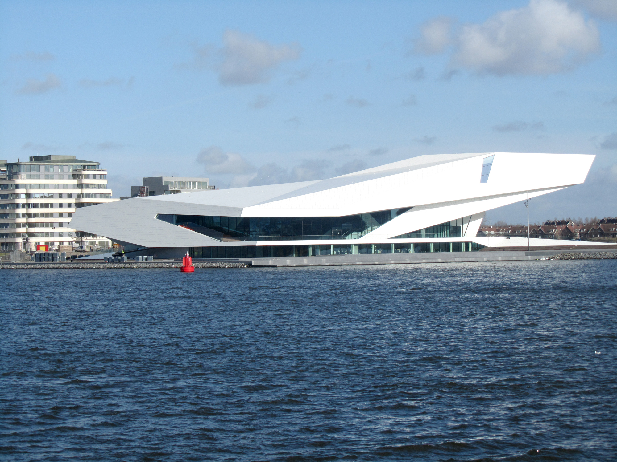
Tutorials
Examples:
Collaborative tutorial with the EYE Film Museum
Aesthetics & Politics of Identity
Doing Videographic Criticism
More-than-human Cities
On Feminism and Pop Culture
Machine Learning
Platforms and Cultural Production
Custom-made tutorial or research internship
Notes:
Another way to develop your program is by following tutorials, this a form of teaching which is unique to the research Master. Tutorials are offered in small groups, of up to five students, in which you intensively discuss and work on a particular topic in about 5 meetings with a member of staff.
Most tutorials are concluded by a paper, but we have also tutorials that produce an event (EYE on Art) or research project (Doing Digital Methods). Lately students have been increasingly active in creating their own custom made tutorials.
Students….

Slide 10
Research Schools
RMeS : The Netherlands Research school for Media Studies https://www.rmes.nl/
NICA: Netherlands Institute for Cultural Analysis
https://www.nica-institute.com/
Always sign up for one Research School, inform me of which one.
Even though signed up to one research school, you can take seminars offered in others
All courses are in English in the Research Schools
Notes:
When you a research master student, you become part of a national research school. Most students become part of RMeS (Netherlands Research School for Media studies). The national research schools also offer courses, such as Trending Topics, which has been popular with rMA students and in which you meet faculty from different universities. And this year contemporary approaches to digital cultures.
The rMES Summer School has also been very popular, great opportunity to meet PhD’s, staff and rMA students from other universities. Finally, the national research schools offer Master classes, for which you can also earn credits.
Students….

Slide 11
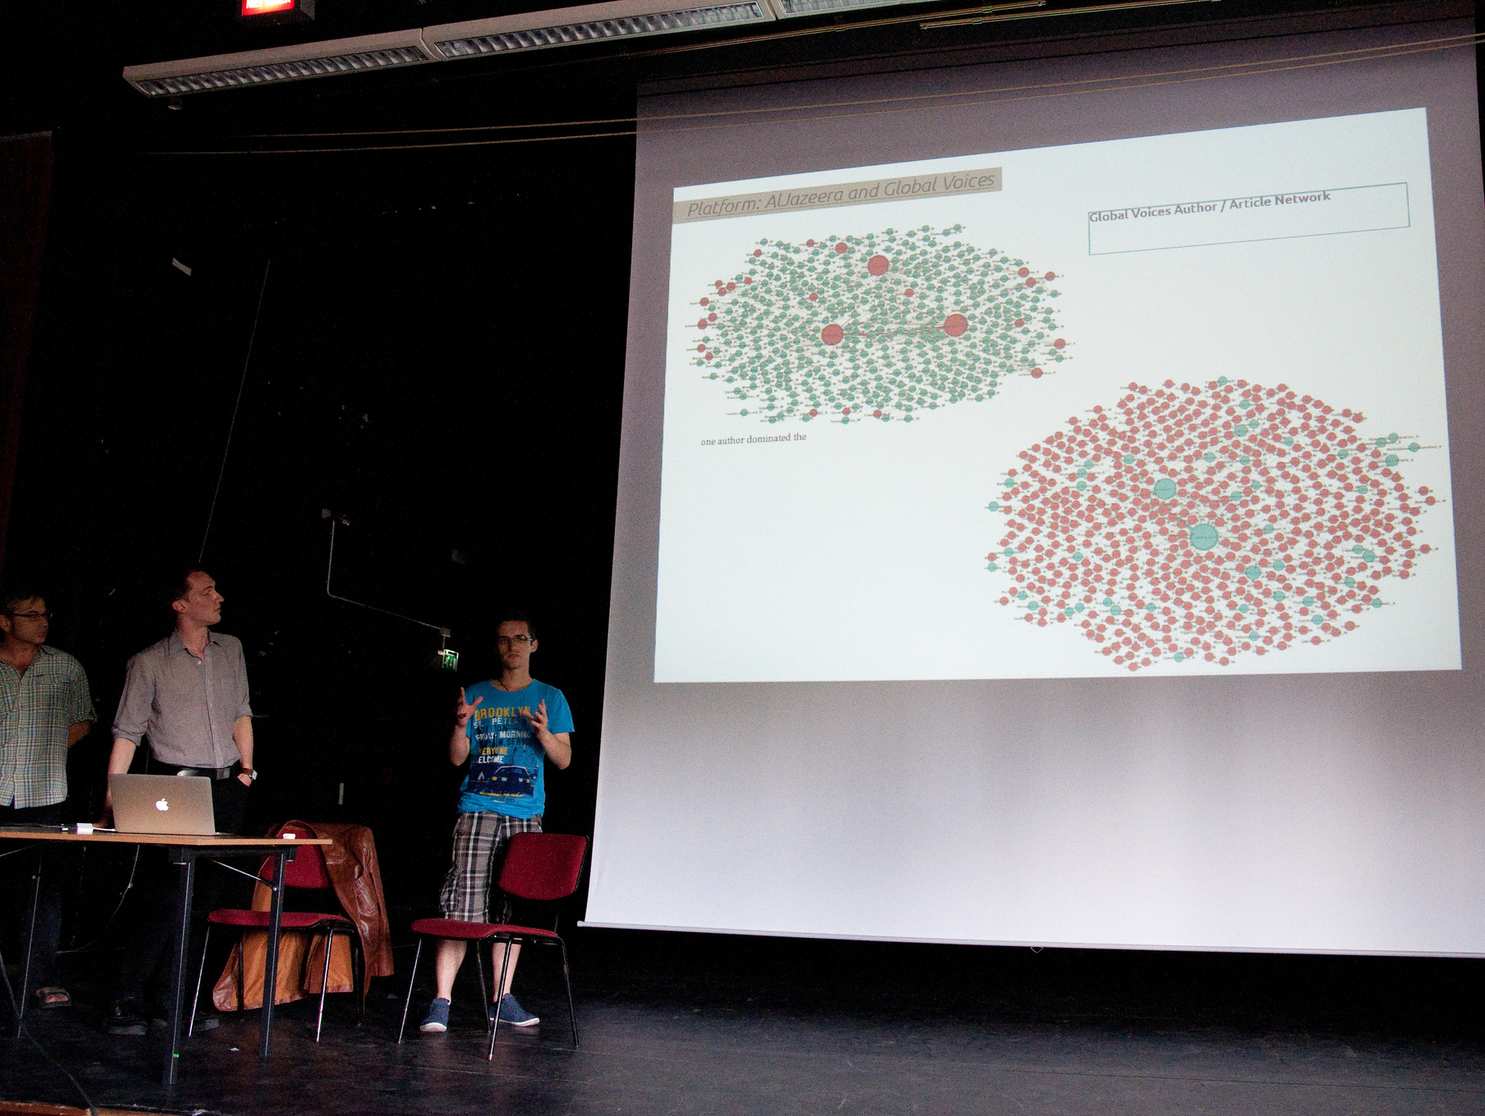
Digital methods summer school
Notes:
It is also possible to follow other summer and winter schools for credit in Amsterdam, such as the Digital Methods Summer School, which really intensive research event that draws research master students, PhDs and scholars from around the world.
But you can also follow summer and winter schools elsewhere in the world for credit. There is room in the program to do so.

Slide 12
Thesis project (sem. 4)
Research Master Thesis Media Studies (18 ECTS)
Supervised by a member of staff, one additional reader
Thesis seminar (6 ECTS)
Developing the proposal and components of a thesis
Thesis Conference (6 ECTS)
Present your work to others in a conference setting
Notes:
Finally, the thesis project, which takes the entire fourth semester, and allows you to dive deep into a project of your interest, in collaboration with a supervisor.
This project is also supported by two course, the thesis related seminar, which helps you to develop the outline of your thesis, and first chapters. And the Thesis Conference, in which you present, discuss your work, and place it in a public context.

Slide 13
Amsterdam School of Cultural Analysis (ASCA)
ASCA Reading Groups: Trans-Asia Cultural Studies, Women in Theory, Marxist Reading Group, Neuroaesthetics and Neurocultures, Trans and Psychoanalytic Perspectives, etc.
ASCA Seminars: Cities Seminar; Rethinking Cross-Media Seminar, Online Contention, etc.
ASCA Conferences
Notes:
Beyond the regular teaching, it is particularly interesting to checkout the activities of the local research school ASCA of which most Media studies staff is a member. It is the main home of many of our PhD students.
This is where a lot of reading groups, seminars, and conferences are organized! Here you can see some of them.

Slide 14
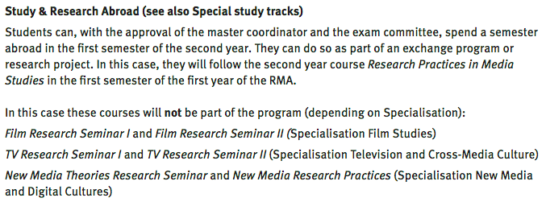
Study Abroad

Slide 15
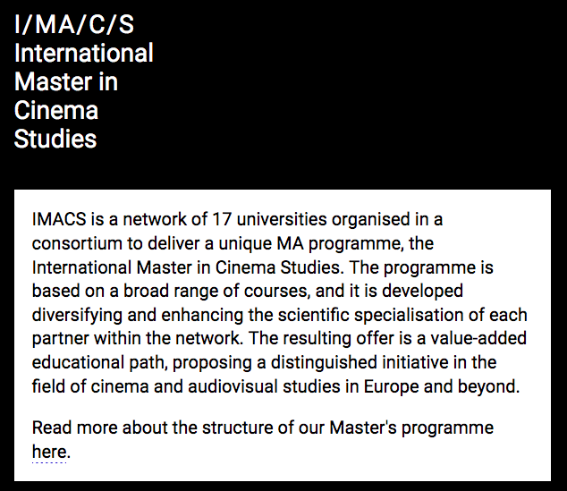
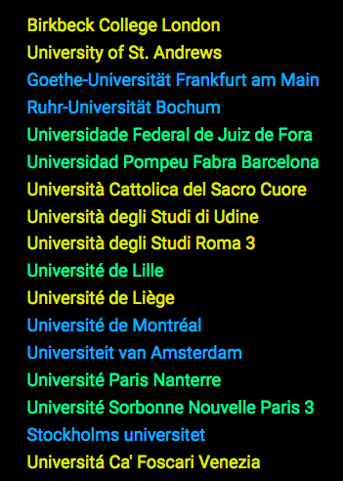
http://imacsite.net, Marie-Aude Baronian (m.a.m.b.lousbaronian@uva.nl)
Notes:
the best ones in the field: London, Paris, Lille, Liège, Milano, Rome, Udine, Bochum, Frankfurt, or Montréal !. IMACS is not the same as an ERASMUS. It is not only the opportunity to become familiar with other cultures and languages (by the way there are courses offered in English) but to be part of this academic community (e.g: Phd)…
Please contact Marie-Aude Baronian for further details (lousbaronian@uva.nl). See also the website of this International Program (Master international en études cinématographiques et audiovisuelles): http://imacsite.net/.

Slide 16
Career Prospects
Public/private institutions: Government agencies; education, media and cultural institutions; film festival organisations; as well as in museums, broadcasting companies, digital strategy agencies and archival organisations.
Academic: Lecturer or researcher in media studies, PhD programme in the Netherlands or abroad in a discipline related to Media Studies.
Notes:
Great demand for expertise in each of the specializations, at a wide variety of places Government agencies, advisory boards, education, media and cultural institutions, as well as in museums, broadcasting companies, and digital publishing and archival organisations.
Over the past years, our Research Master's students have found PhD places in the Netherlands at the universities of Amsterdam, Utrecht, Groningen, and Maastricht, as well as abroad at, among others, the University of California, Los Angeles, Lund University, University of Siegen, and Mainz, Liege, Stockholm.
2 jaar na het MA diploma heeft 86% van de afgestudeerd FGW-ers een baan.

Slide 17
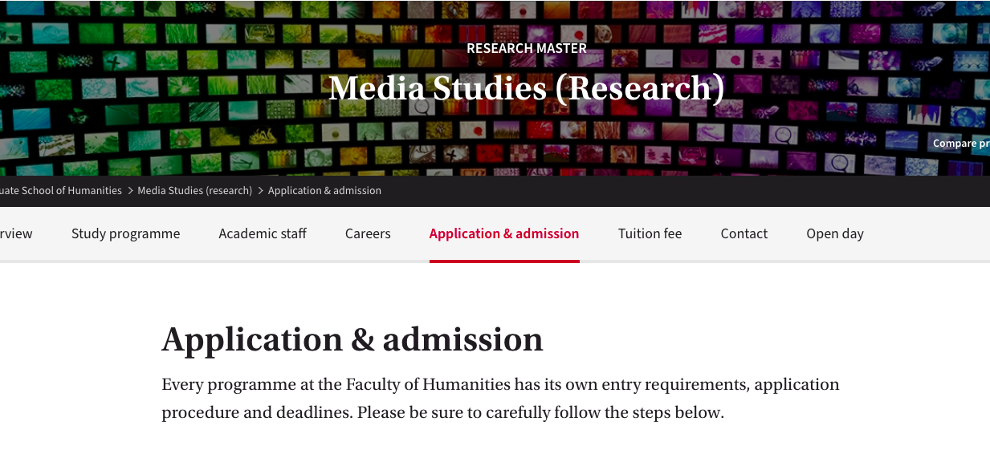
https://www.uva.nl/en/programmes/research-masters/media-studies-research/application-and-admission/application-and-admission.html#4-Submit-your-application-form-in-MyInfo

Slide 18
Application Process & Eligibility
The RMA has a selection procedure that takes into account:
previous studies (subject matter, grade average);
previous work and motivation (writing sample, motivation letter);
English language proficiency;
Focus on the quality of written material!
Eligibility criteria:
Bachelor’s degree in media, communication or similar
  OR one semester’s worth of media-related coursework
Minimum 7.5 GPA or equivalent
Notes:
This is a selective master, with a selection procedure in which we especially want to see whether the program would a good match for you, and you for the program:
previous studies (subject matter, grade average);
previous work and motivation (writing sample, motivation letter);
English language proficiency;
Focus on the quality of written material!

Slide 19
Scholarship information
Information about the Amsterdam Merit Scholarship as well as loans and financial aid can be found here:
https://www.uva.nl/en/education/fees-and-funding/masters-scholarships-and-loans/scholarships-and-loans.html

Slide 20

Application deadline: 1 March 2023
Application process: https://gsh.uva.nl/application-and-admission/application.html
Tuition fee calculator:
https://uva-ac.topdesk.net/xfg/enguvawizard
(use ‘media studies’ as prompt under ‘choose your programme”)
Notes:
Note that the deadline for application is really quick on March 1, 2017!

Slide 21
Miscellany: Application Process
You will hear back between mid- to end-April
Never exceed the 3000 word limit for the writing sample
If your prior education was in English, then no English tests required
No recommendation letters required
The RMA has only one start date: September.
Further specific details about application:
https://www.uva.nl/en/programmes/research-masters/media-studies-research/contact/contact-and-open-days.html

Slide 22
In Summary
The RMA-Media Studies is a programme for students with a passion for research who want to acquire both broad and specialized knowledge in the field.
The program allows for a lot of choice, combines various teaching forms and requires initiative and active engagement.
The program aims at developing the central skills for academic research and research in public/private institutions related to media.
Notes:
To summarize:
The rMA media studies is a program for students with a passion for research who want to acquire both broad and specialized knowledge in the field.
The program allows for a lot of choice, combines various teaching forms (small scale) and requires initiative and active engagement.
The program aims at developing the central skills for academic research and beyond.

Slide 23
Questions?
Dr. Sudeep Dasgupta, program coordinator
malchum@gmail.com
Notes:
Feel free to approach us now if you have questions, or mail Thomas for an appointment.

