Slide 1
UvA Mastersdag
MA Comparative Cultural Analysis
rMA Cultural Analysis
Dr. Niall Martin Camila de Mussy
Jakob Henselmans

Slide 2
Comparative Cultural Analysis/Research Master Cultural Analysis
  What is Cultural Analysis?
  General Introduction to programs
    Differences & Similarities
    Core course examples
    Structure of programs
  Why study with us?
  Practical information
  Current students’ experiences
  Time for questions

Slide 3
So what is Cultural Analysis? (in two sentences)
Cultural analysis is a theoretically-informed, interdisciplinary analysis of cultural objects that engage with contemporary social and political questions, including the questions raised by the practice of analysis itself.
Cultural Analysis typically appeals to researchers in humanities disciplines who find the methodologies associated with their discipline too restrictive to pursue the questions posed by their objects of research.

Slide 4

So what is Cultural Analysis? (in one url)
https://soapboxjournal.net

Slide 5
Shared elements of both programs:
Focus on interdisciplinarity
Attention to the interconnection between cultural artifacts, contemporary culture, and theory
Freedom to follow your research interests

Slide 6
Differences between programs
Time frame: 1 vs 2 years
  Space for electives / tutorials / research project
Content: different core courses
  Core courses of CCA are both methodological and content-oriented (Intercultural dialogues I & II)
Prospects
  PhD / job in the cultural sector?

Slide 7
How to choose?
How much time would you like to devote to your MA?
How deep would you like to delve into the material?
How much freedom would you like to have?
Where would you like to go from here?
… What if you change your mind?

Slide 8
Switching from CCA → CA
Option 1. Deadline: 9 January
Admission criteria
+ Study Plan, transcript of your grades
Transfer of credits
Option 2. Deadline: 1 March
Admission criteria
Transfer of credits (usually: minus thesis)
NB: extra semester
https://gsh.uva.nl/programmes/transferring-to-a-research-masters/transferring-to-a-research-master.html

Slide 9
Study Plan MA CCA
Semester 1 | Semester 2
Objects of Cultural Analysis (12 EC) | Concepts for Cultural Analysis (12 EC)
Block 1-2: Elective(s) (12 EC) | Block 1-2: Elective(s) (12 EC)
Tutorial Cultural Analysis (6 EC) | Tutorial Cultural Analysis (6 EC)
Year 1
Semester 1 | Semester 2
Comparative and Cultural Analysis (12 EC) | Electives (12 EC)
Intercultural Dialogues 1&2 (12 EC) | Thesis (18EC)
Thesis Seminar (6 EC)

Slide 10
Methodology Course Example MA
Comparative Cultural Analysis
Objectives:
To learn how to choose and work with the object of one’s research project.
To become familiar with the skills it takes to conceptualize an object of study (not too broad, not too narrow, originality and feasibility issues);
To research and critically deploy relevant theories and formulate research questions.
To be able to collaborate with other students on ongoing research projects (presentation skills, give and get meaningful feedback);
To start working on what will become the object of study for the MA thesis or future independent research projects.

Slide 11
Core Course Example MA
Comparative Cultural Analysis
Intercultural Dialogues II
This course is dedicated to the comparison, dialogue, and communication between different cultural expressions, experiences and forms – including the failures, breakdowns, misunderstandings, and blind spots that such interactions typically contain. Through contemporary processes of globalization, social and political mobilizations and migration, the borders and interactions between different cultures are erratically and unpredictably redrawn, allowing for new forms of interactions as well as imposing new blockages.
How can these intensely ambivalent instances of increased contact and distance be navigated academically and politically? Can literature and the arts help us to perceive both the possibilities and drawbacks of our globalizing world? What are the travelling forms of action, imaginations and mobilizations; how do they talk to each other and how do they fail to talk to each other?

Slide 12
Study Plan rMA Cultural Analysis
Semester 1 | Semester 2
Objects of Cultural Analysis (12 EC) | Concepts for Cultural Analysis (12 EC)
Block 1-2: Elective(s) (12 EC) | Block 1-2: Elective(s) (12 EC)
Tutorial Cultural Analysis (6 EC) | Tutorial Cultural Analysis (6 EC)
Year 1
Semester 1 | Semester 2
Objects of Cultural Analysis (12 EC) | Concepts for Cultural Analysis (12 EC)
Block 1-2: Elective(s) (12 EC) | Block 1-2: Elective(s) (12 EC)
Tutorial Cultural Analysis (6 EC) | Tutorial Cultural Analysis (6 EC)
Year 2
Semester 1 | Semester 2
Research Seminar Cultural Analysis (12 EC) | Research Project Cultural Analysis (12 EC)
Block 1-2: Elective(s) (12 EC) | Research MA Thesis Cultural Analysis (18 EC)
Tutorial Cultural Analysis (6 EC)

Slide 13
Core Course Example rMA Cultural Analysis: Concepts
In today’s Humanities research, concepts are no longer easily reduced to specific disciplines, methodological systems, or theoretical allegiances. On the contrary, concepts seem simply “around,” travelling between contexts, methods, disciplines, and fields. Concepts have thus become sites of intense dialogue, scholarly production, and innovation—as well as of endless misunderstanding, polemics, hypes, and academic “tunnel vision.” This class aims to give students a handle on how to deal with theoretical concepts productively and critically for their own research projects. Today, what can we do with Concepts? What can we not? Where do they help, and where do they hinder?
Concepts 2020-2021: Precarity, Crisis, Infiltration, Wildness

Slide 14
Concepts
… accelerationism, affect, agonism, algorithm, the Anthropocene, archive, biopolitics, camouflage, care, class, the commons, creativity, crip theory, crisis, cultural memory, curating, debt, decolonialism, heteronormativity, image, immaterial labour, immunity, intersectionality, justice, life, love, medicalization, multitude, neoliberalism, network, noise, plasticity, postcolonialism, the post-political, posthumanism, post-truth, prosthesis, race, rhythm, rudimentariness, spectacle, speculation, surveillance, the sensible, utopia, war …
https://www.soapboxjournal.net/glossary

Slide 15
Current and recent electives within the department:
Gender, Bodies and the Post-Human
History, Cultural Memory and Trauma
The Extreme Contemporary Novel
Narrative and Globalisation
Sex/Race/Trans: Human Life Forms
Coetzee and Grunberg
Il/Literacy Matters: Spaces, Bodies, Species
Intercultural Dialogues 1 & 2
Politics of the Contemporary 1 & 2
….
Tutorials, Stages/Internships, National research school courses…

Slide 16
Why Study with Us?
International environment, attracts international students from around the world
Attracts students from various disciplinary, personal and professional backgrounds
Focus on interdisciplinarity
Contemporary view on cultural artifacts, culture, and theory
Freedom to choose courses from a wide variety of departments
Intimate sphere, direct contact between students and teachers
Independent research (with guidance)
High level of theory
International academic network

Slide 17
Why Study with Us?
Since 2001, the Research programs in Cultural Analysis have rapidly gained a leading reputation in the field and is attracting growing numbers of high-level applicants from around the world
The programs are closely tied to the larger research school of ASCA (Amsterdam School for Cultural Analysis) and NICA (Netherlands Institute for Cultural Analysis)
Students are invited to follow and actively participate in the research events of ASCA and NICA (conferences, seminars, keynote lectures)

Slide 18
Why Study with Us?
ASCA is unique in the Netherlands and one of the leading programs of its kind worldwide
More than 50 scholars and 120 PhD candidates in film and media studies, literature, philosophy, visual culture, musicology, religious studies, and more
Variety of research constellations (mediality, aesthetics, globalization and migration, identities, cultural and social critique = MAGIC!)

Slide 19
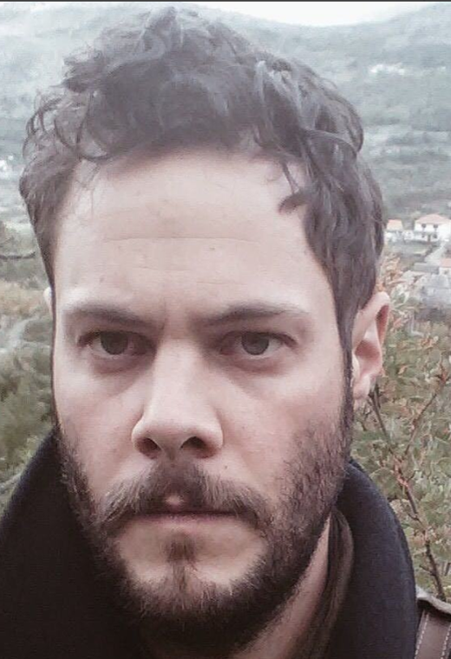


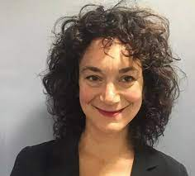

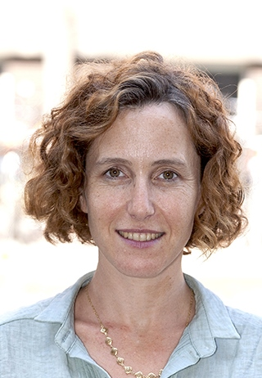
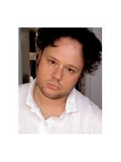
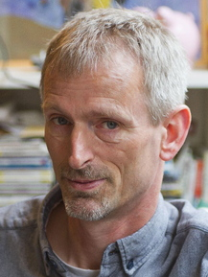
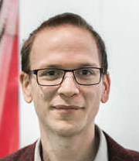

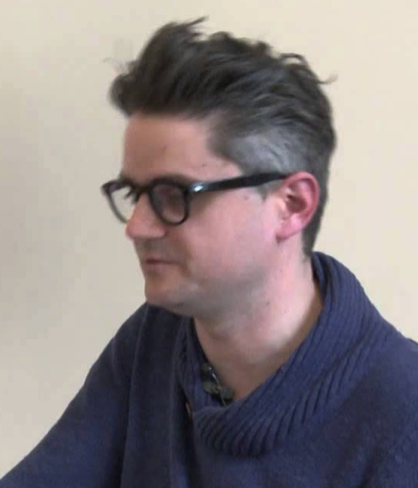
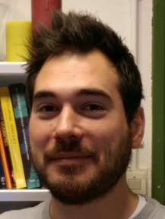
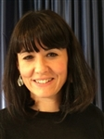


2017 Team MA Comparative Literature
Why Study with Us?

Slide 20
Where Will You Go from Here?
Jobs in the cultural sector: editor for a publishing company, employee at a cultural or scientific organization; education, journalism, media, communications, NGOs, politics, museums, etc.
Moving on to a research Master (Cultural Analysis or Literary Studies, etc.) and possibly an academic career (PhD programs all over the world)

Slide 21
Queen Mary’s University London
Royal Holloway, London
Universities of Leeds,
Sunderland,
Groningen,
Heidelberg,
Potsdam,

Slide 22
Giessen, Lisbon, Copenhagen,
Beijing,
Vancouver,
University of Pennsylvania,
Stavanger

Slide 23
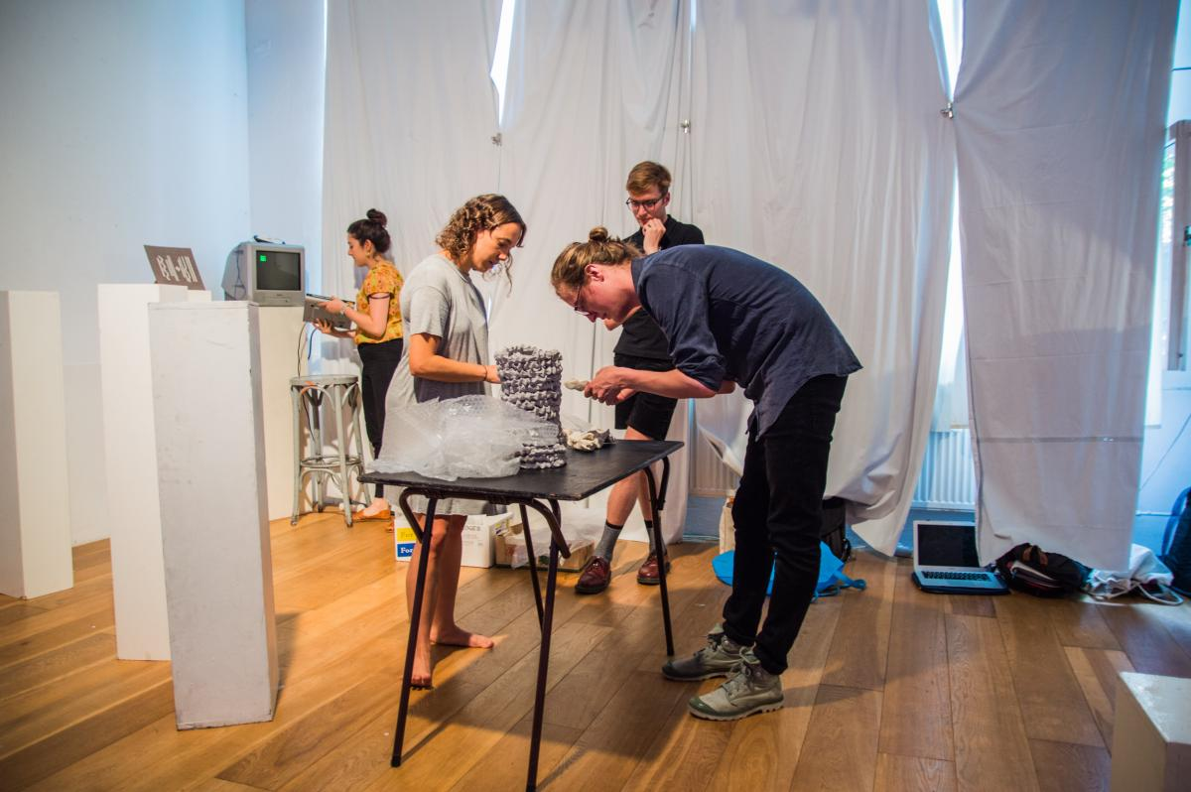
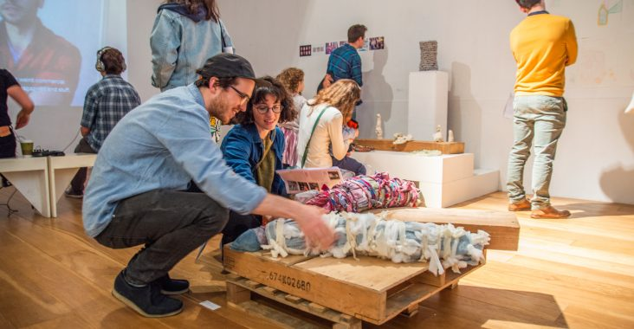
Student life:
https://soapboxjournal.net

Slide 24
Practical Information
Graduate School of Humanities:
Application Guidelines, deadlines, finances, language and other requirements: admissionsma-fgw@uva.nl
www.uva.nl/master
http://gsh.uva.nl
MA Coordinators:
Niall Martin n.martin@uva.nl
Joost de Bloois j.g.c.debloois@uva.nl

Slide 25
Comparative Cultural Analysis/Research Master Cultural Analysis
  General Introduction to programs
    Differences & Similarities
    Core course examples
    Structure of programs
  Why study with us?
  Practical information
  Current students’ experiences <
  Time for questions

