Slide 1


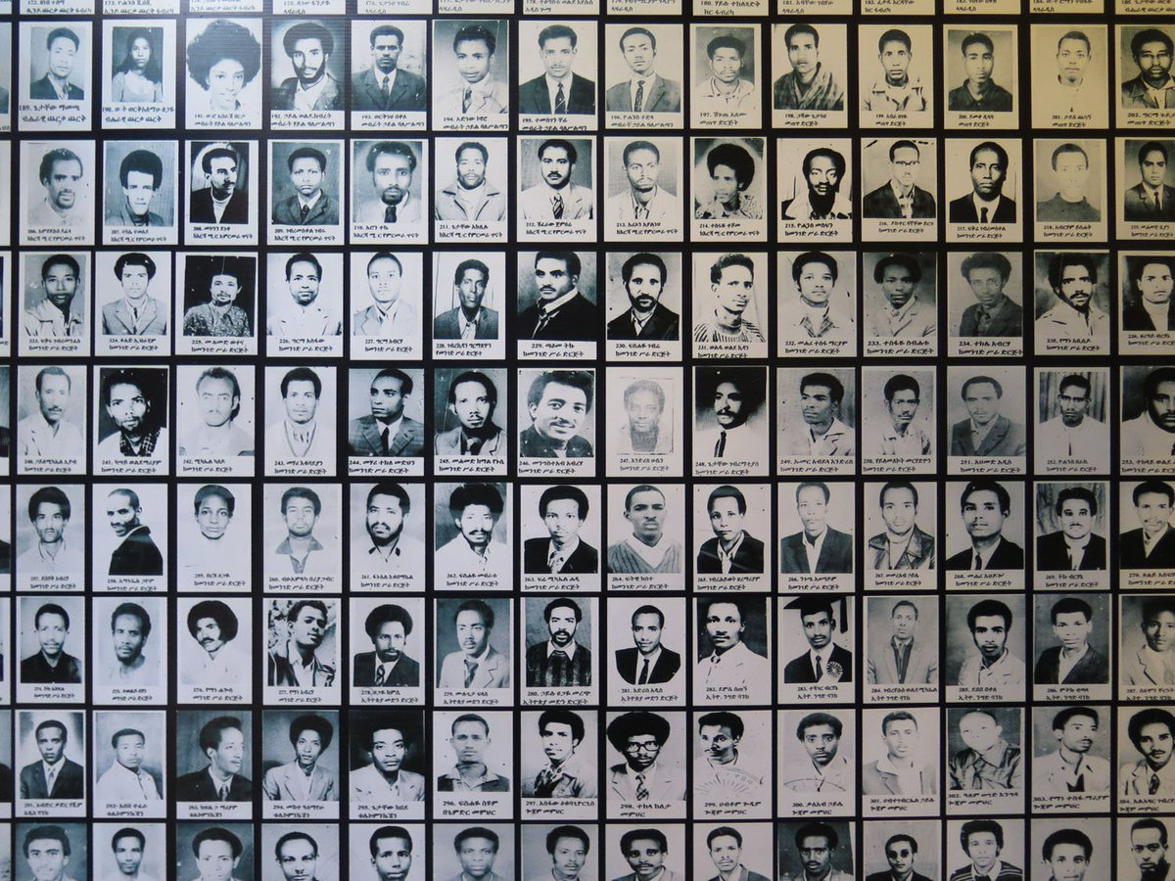
Holocaust and Genocide Studies

Slide 2
Quick round
Who are you?
What is your academic background?
Why this MA?
What do you hope to learn?
Notes:
We have a mixed class

Slide 3
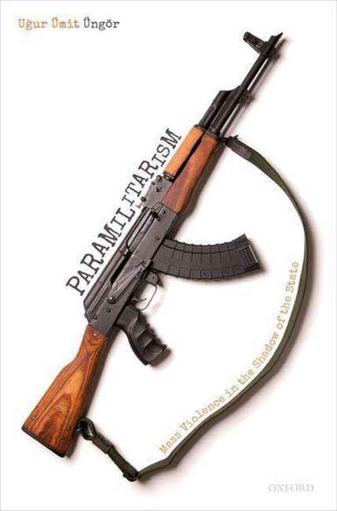
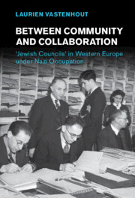

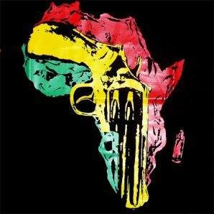
About us
Prof. Dr. Uğur Üngör
Dr. Thijs Bouwknegt
Alexeï Delanghe
Other faculty
Prof. Dr. Nanci Adler
Dr. Laurien Vastenhout
Guest lecturers

Slide 4
Why study genocide?
Understanding Mass Violence & Genocide as a process
    Causes – Courses – Consequences
Why do people kill?
How can we explain that genocide and mass violence has occurred in societies that vary:
    Temporally / Geographically / Economically / Culturally /
    Technologically / Politically / etc.
Goal: Understanding and explaining mass violence from different perspectives
Notes:
Understanding the Unthinkable
Genocide and mass atrocities are often presented in a way that makes violence seem inexplicable, thus inexorable. Similarly perpetrators are portrayed as being actors motivated solely by an irrational hatred. And yet, genocide is a recurrent and contemporary historical dilemma. How can we explain this discrepancy? In our programme we seek to demystify genocide by taking an interdisciplinary, scholarly approach to understanding genocide and mass atrocities.
Studying Holocaust and Genocide Studies at the University of Amsterdam
Key features of the Master's programme Holocaust and Genocide Studies:
The curriculum focuses on genocide and mass atrocities in the 20th century, encompassing the Holocaust, the Rwandan Genocide, the Armenian Genocide, Cambodia, and other contemporary cases.
Our engagement with genocide is wide-ranging from the causes of genocide, to representations of genocide in the arts, to transitional justice following mass atrocities.
Our student body is increasingly international.
The programme is a collaboration between the University of Amsterdam and the Netherlands Institute for War, Holocaust and Genocide Studies. This integration of the programme with a well-established (more than 70 years old) research and archival centre makes the programme unique. Students will have access to a specialised library of war, Holocaust, and genocide studies, as well as the potential draw the more than 2,500 metres of archival materials managed by the NIOD, and the expertise of NIOD researchers. NIOD archivists are also currently involved in archiving projects relating to the Gacaca Archives in Rwanda, and the ICTY archives.
The context of the Netherlands offers our students several advantages including the opportunity to visit genocide-related sites, as well as the international criminal tribunals in The Hague.

Slide 5
Topics
Cases: USA, Canada, Congo Free State, Namibia, Armenia, the Holocaust, Indonesia, Burundi, Cambodia, Rwanda, Yugoslavia, Sudan, Syria, Myanmar, Central African Republic.
Themes:
  History of Genocide & Crimes Against Humanity;
  Theory of Genocide and Mass Violence;
  Cultural Genocide;
  Ideology and propaganda;
  Comparing genocide geographically;
  Perpetrators & Perpetration;
  Victims & Bystanders;
  Transitional Justice.
Methodology:
  Secondary literature;
  Archival investigation;
  Ethnographic fieldwork, e.g. Bosnia, Cambodia, Rwanda, etc.
  Oral history.

Slide 6


www.niod.nl
Notes:
During the Second World War plans were already made to establish a war documentation centre after the liberation. A group of Dutch professors, led by historian Professor Dr. N.W. Posthumus, expanded this idea. Their main focus was to collect and order original documents about the Netherlands during the German occupation.
Abroad, the Dutch government in exile in London fully agreed with the professors. In March 1944, for example, Dutch Minister of Education, Culture and Science Bolkestein appeared on Radio Oranje to request the Dutch population to safely keep their diaries and letters. Once the Netherlands was set free, they would be collected.
The Netherlands was liberated on 5 May 1945. It did not take long to open a documentation centre; only three days later the National Bureau for War Documentation was founded. On 1 October 1945 the historian Dr. Loe de Jong, who had worked for Radio Oranje in London during the war, was appointed director. The National Bureau changed names and became the State Institute for War Documentation, in Dutch Rijksinstituut voor Oorlogsdocumentatie (RIOD).
Collecting documents
In the first years after the war the Institute’s main task was to collect original documents about the Netherlands and the Dutch East Indies during the Second World War. Through radio announcements, newspaper advertisements and posters the Dutch population was encouraged to donate documentation.
Important objects, such as diaries, letters and photo albums were handed over to the institute. Staff of the documentation centre also proactively searched for documentation. For instance, In 1946 Dr. Loe de Jong and deputy director Dr. A.E. Cohen discovered a large part of the archive of the Reichskommissariat in den Niederlanden in Münster.
Research activities
In addition to collecting and organising all these documents RIOD also did research. Its most famous publication is, without a doubt, Het Koninkrijk der Nederlanden in de Tweede Wereldoorlog by Loe de Jong. The multivolume series was published between 1969 and 1988.
Apart from De Jong’s magnum opus his fellow researchers also published a number of studies, which are still considered classic works within the historiography of the Second World War in the Netherlands and the former Dutch East Indies.
The 1990s were marked by significant changes within the documentation centre. In 1997 the institute moved from its old address at the Herengracht 474 to its current location at the Herengracht 380.
In 1999 the institute became part of the Royal Netherlands Academy of Arts and Sciences (KNAW) and changed its name into Netherlands Institute for War Documentation (NIOD).
A more international approach
The most important change was a thematic one: at the start of the new millennium, NIOD, under its director Prof. Dr. Hans Blom, embraced a more international approach. The research field was expanded in terms of time and geography.
The prewar years, the aftermath and the reconciliation with the Second World War redefined the scope of NIOD’s research projects. The focus also shifted to events in the former Dutch East Indies and international comparative research.
n 2010 NIOD merged with the Centre for Holocaust and Genocide Studies (CHGS) to become NIOD Institute for War, Holocaust and Genocide Studies.
Since its foundation in 2002, CHGS had rapidly developed into an independent institute. Through academic and public activities CHGS approached the current problems of genocides as a worldwide phenomenon from a comparative perspective. In 2008, for instance, CHGS organised the international conference ’60 Years Genocide Convention’. Together with the University of Amsterdam CHGS was involved in setting up a Masters in Holocaust and Genocide Studies.
Like NIOD, CHGS’ activities touched the borderline between science and society. While NIOD used the Second World War as its starting point, CHGS covered the entire world, using as a benchmark the concept of genocide and discussions about it.

Slide 7
Courses, 2023-2024
Semester 1:
1. Core Course (18 ECTS)
2. Topics in Holocaust Studies (6 ECTS)
3. Topics in Transitional Justice (6 ECTS)
Start work on Thesis
Electives Semester 2:
1. Mass Violence in the Middle East (6 ECTS)
2. Mass Violence in Africa (6 ECTS)
Thesis (18 ECTS)

Slide 8
Selection criteria
Background: History, sociology, int’l criminal law, genocide studies, conflict studies, ethnic studies, global history, area studies, memory studies, human rights
Advanced English
Clear interest: in genocide or related topics
Motivation: substantial letter of motivation (max. 1 A4)
Research proposal: A proposal (in narrative form, max. 2,000 words) for an academic research paper related to the analysis of a theme, theoretical conundrum or case study relevant to genocide, mass violence, the Holocaust, or transitional justice.
CV
Excellent scholarly abilities:
Good academic track record, i.e. high grades.
Writing skills, i.e. essay, thesis, or article (in English).

Slide 9
Student Experience

Slide 10
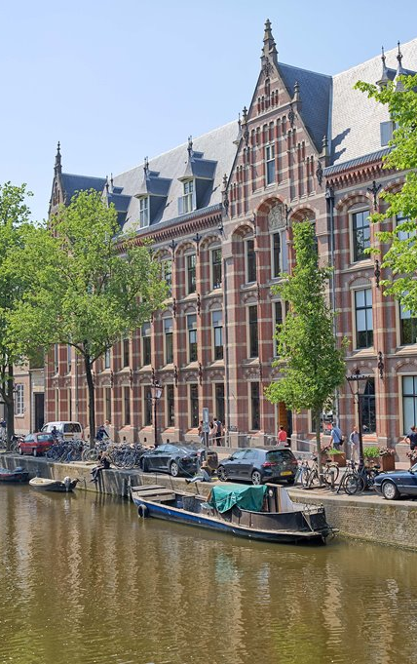
Deadlines
1 March 2023 (incl. language test)
Studielink
Decision: Before 1 May 2023
https://gsh.uva.nl/content/masters/holocaust-and-genocide-studies-history/holocaust-and-genocide-studies.html
Contact: ma.hgs@niod.knaw.nl

Slide 11

Q&A

