Slide 1
UvA Open House
Master European Studies
Information Session
Identity and Integration
Thursday 10 November 2022
Track Coordinator Marleen Rensen

Slide 2
Programme
19.00: Introduction
  Marleen Rensen
19.20 : Students’ Perspectives
19.40: Questions & Answers
20.00: Closure

Slide 3
Introducing Identity and Integration
One of three specialised tracks rooted in the ES department
  East European Studies
  European Policy
  Identity & Integration
Focus on issues of identity and cultural diversity
Situate contemporary issues in a cultural historical perspective
Analyse intersections of culture and politics

Slide 4
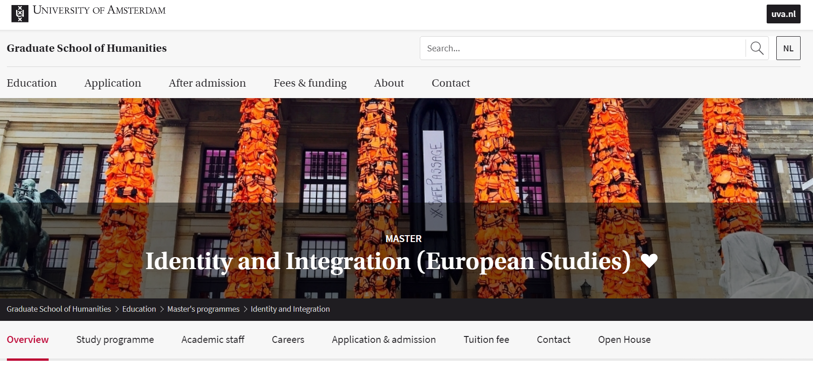

Slide 5
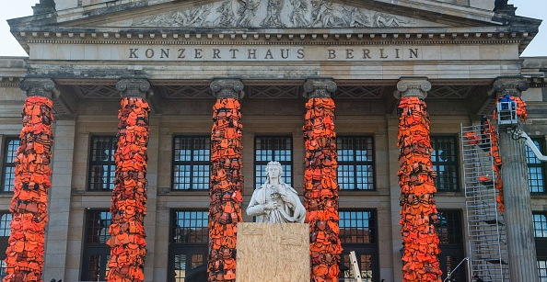
Ai Weiwei - Refugee Art Installation 2016

Slide 6
Identity and Integration offers:
A cultural historical perspective on contemporary issues in Europe
Specialized knowledge of:
  cultures of nationalism and national identities
  ideas of Europe and European identity,
  the political aspects of European cultures,
  the employment of culture in community-building policies and practices in the EU.
A comparative and transnational approach to analyze related issues.
Opportunities to meet and engage with experts from outside the academic world who give insight into culture and history and their relevancy in policies and practices.
A seminar and (sponsored) study trip to one of Europe’s Cultural Capitals.

Slide 7
Programme MA European Studies
 | SEMESTER ONE |  |  | SEMESTER TWO
 | Block 1 (8 weeks) | Block 2 (8 weeks) | Block 3 (4 w.) | Block 4 (8 weeks) | Block 5 (8 weeks) | Block 6 (4 w.)
Course 1 | Imagining the Nation : Cultures of Nationalism (6 EC) | Imagining Europe: Ideologies and Power (6 EC) | Skills Workshop European Capitals of Culture (6 EC) | MA Thesis (18 EC)
Course 2 | Course 1 (6 EC) | Course 2 (6 EC) |  | Course 4 (6 EC) | Course 5 (6 EC)
Two Core Courses + Skills Workshop (18 EC)
Two Restricted–Choice Electives (12 EC)
Two Free-Choice Electives (12 EC)
MA Thesis (18 EC)

Slide 8
Programme-bound electives
Examples:
Europe and its discontents: A political history of Anti-liberalism
Encountering Diversity : Travel writing in East/West Europe
Facing Srebrenica: Representing Genocide in Contemporary Europe
European Cultural Policy

Slide 9
Students’ Perspectives
William Goedbloed
Amira Salama

Slide 10
Thesis Topics
National Identity in Contemporary Cinema in Cyprus
Surinamese Jazz Musicians in Interwar Amsterdam
The image of Paris in Netflix Series ‘Emily’
Colonialism in Dutch Museums
The Greek MeToo Movement
Bosnian War Remembrance
Comparison of Dutch PVV and Spanish VOX
Feminist Analysis of Erdogan’s Speeches

Slide 11
Career Perspectives
Policy officer governance (local, national, European level)
Journalist
Museum curator
Event programmer cultural institution
Officer at publishing house
Phd candidate
Teacher secondary education
Policy officer migration and refugee center

Slide 12
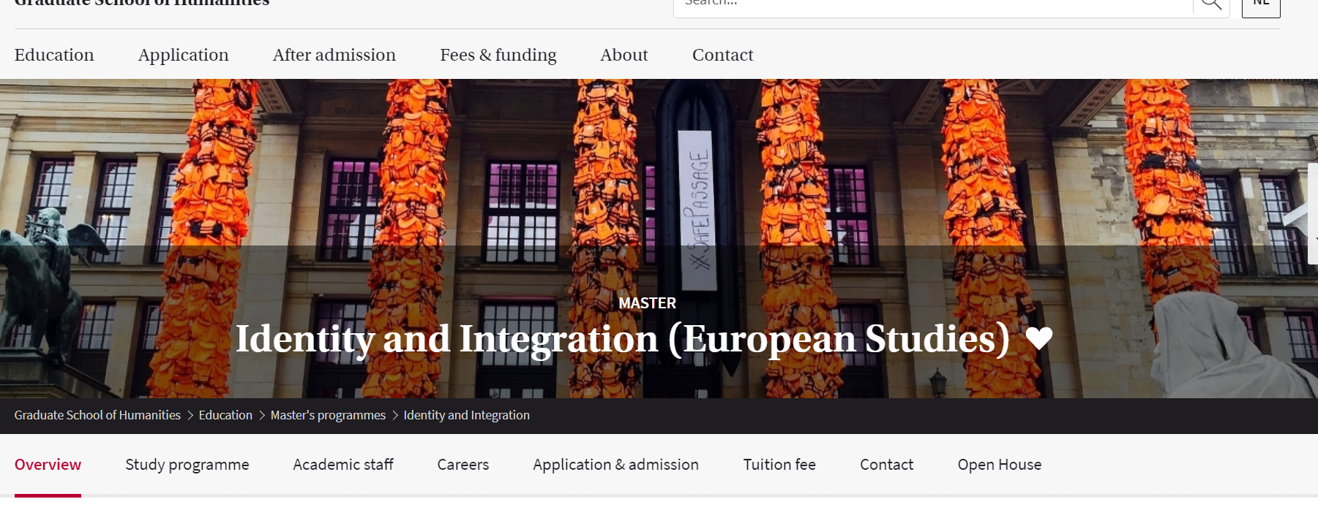
Questions and Answers
Visit us online:
https://gsh.uva.nl/content/masters/identity-and-integration-european-studies/identity-and-integration.html

