Slide 1

Language & Society /
Language, Literature & Education
UvA Master’s Day
Dr. Robert A. Cloutier, coordinator L&S / LL&E 9 November 2022

Slide 2
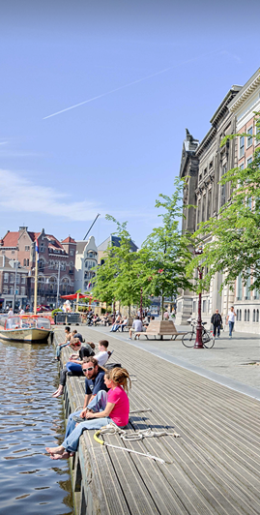
Presentation Outline
Information
  Why an MA in Linguistics/Literature at the UvA?
    but NOT entry requirements—contact Admissions
  Programmes in detail
  Future Perspectives
Student perspective
  Dylan Flaks (L&S)
  Anaïs Bölderl (LL&E)
Q&A

Slide 3
Why an MA in Linguistics/Literature at the UvA?
Academic setting
  2021: Linguistics at UvA ranks 20th in QS World University Ranking by Subject, highest ranking in continental Europe!
  Excellent research facilities
Diversity
  International group of staff and students
  Different theoretical approaches come together
  Many languages are offered
Location
  Multilingual city
  Rich historical and cultural heritage
Notes:
Highly ranked
16th in QS World University Ranking by Subject, highest in continental Europe
Research facilities
Phonetics lab
Baby lab
Eyetracking lab
Various theoretical approaches
sociolinguistics, generative approaches, functional approaches
phonetics/phonology, morphosyntax, discourse analysis, identity

Slide 4
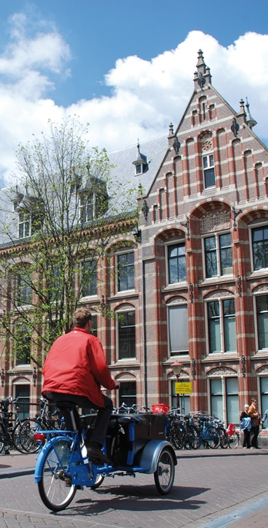
Language MA programmes
 | Language & Society | Language, Literature & Education | Literature, Culture & Society
Target Languages | Deutsch, English, Español, Français, Italiano, Skandinavisk, Славянские языки
Focus | (Socio)linguistics | Language, linguistics and literature with education | Literary/cultural analysis
Electives/ Internship | 18 EC | 12 EC | 24 EC
Master Leraar VHO | Yes, if | Yes, if

Slide 5
Language MA programmes
 | LL&E (1 year) + Lerarenopleiding (1 year) | Educatie en Communicatie (2 year)
Languages | Deutsch, English, Español, Français, Italiano, Skandinavisk, Славянские языки | Deutsch, English, Français
Focus | Language, linguistics and literature with education | Education
Electives/ Internship | 12 EC + 3 EC | 15 EC
Thesis | Target language | Nederlands

Slide 6
Language & Society
Block → Semester ↓ | 1 | 2 | 3
1 | Methods in Sociolinguistics | Language Policy and Planning | Term Paper Linguistics
 | Elective | Language specific linguistics course
2 | MA Thesis Language & Society
 | Electives or Internship

Slide 7
Language, Literature & Education
Block → Semester ↓ | 1 | 2 | 3
1 | Literature in the Classroom | Language specific literature course | Term Paper Linguistics / Thesis Seminar
 | L2 in the Classroom | Language specific linguistics course
2 | MA Thesis Language, Literature & Education
 | Electives or Internship

Slide 8
Language-specific courses
Language | Linguistics | Literature
Deutsch | Masterlanguage Deutsch: Deutsch und seine Varianten | Anfang und Ende der Natur: Kultur im Anthropozän
English | Variation and Change in English | Contested Realities: Debating the Novel
Español | Spanish/Hispanic Sociolinguistics and Pragmatics | Crimen y crisis: la novela detectivesca como respuesta a tiempos dificiles
Français | Acquisition & Variation in French | Surréalisme et Littérature
Italiano | Masterlanguage Italiano: Italianissimo: Laboratorio di perfezionamento 1 | La dinamica della letteratura italiana, tra lingue, culture e media
Skandinavisk | Variation and Change in Scandinavian Languages | Narrating the Welfare State in Modern Scandinavian Literature
Славянские языки | Acquisition, Change and Variation in Slavic Languages | Exile in Slavic Literature: Nabokov, Kundera, Milosz

Slide 9

Electives
Elective coursework
  Courses at UvA
  Masterlanguage (Deutsch, English, Español, Français, Italiano)
Internship
  Practical (Ministerie van Defensie, Dutch embassy in Paris, SkyTeam, VluchtelingenWerk Nederland, Vluchtvertraagd)
  Research (ACLC at UvA, Metaphor Lab at UvA, Meertens Instituut)

Slide 10
Job market MA Linguistics

Slide 11
Related MA programmes?
Linguistics
  General Linguistics
  Vertalen
  Research MA Linguistics
Literature
  Literature, Culture & Society
  English Literature & Culture
  Comparative Literature
  Research MA Literary Studies
Specific questions about application and admission
Digital Student Service Desk OR +31 20 525 4481

Slide 12
Admissions and pre-masters
Language & Society | Language, Literature & Education
Equivalent of Dutch academic BA
Proficiency in the target language (e.g., 30 EC of coursework)
15 EC coursework in linguistics
 | 15 EC coursework in literature
Specific questions about application and admission
Digital Student Service Desk OR +31 20 525 4481

Slide 13
Student perspective
  Language & Society
  Dylan Flaks
  Language, Literature & Education
  Anaïs Bölderl

Slide 14
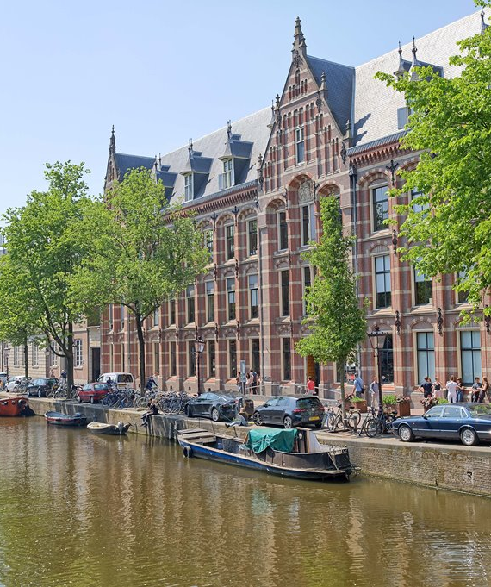
Deadlines
1 March 2023
All applicants with a non-EU/EEA nationality
15 May 2023
Applicants with a Dutch or other EU/EEA* nationality applying to non-selective Master's programmes
* If you are an applicant with an EU/EEA nationality and wish to apply for housing, you must submit your application by 1 March 2023.
www.gsh.uva.nl

Slide 15

Further questions?
Program coordinator
r.a.cloutier@uva.nl (L&S; LL&E)
Graduate School of Humanities
http://gsh.uva.nl/

