Slide 1

Advanced Master’s in Latin American Studies
Information Session
Fabio de Castro and Bente van de Nes

Slide 2
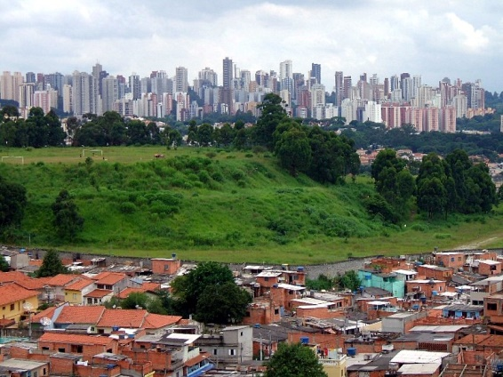

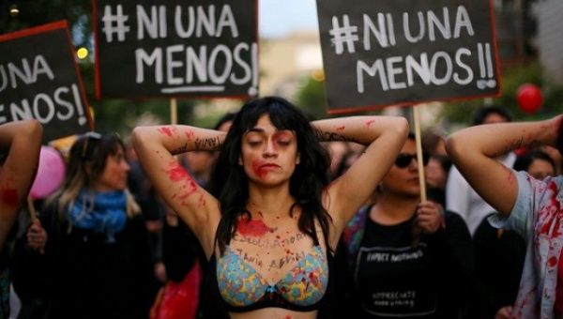
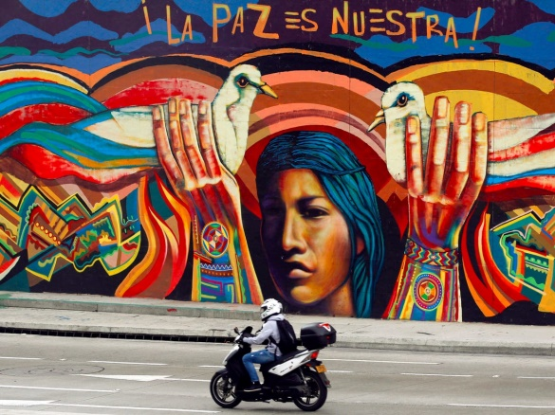
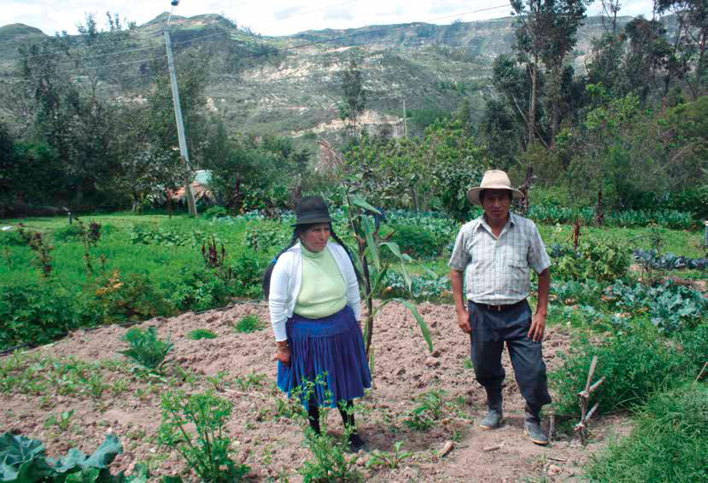
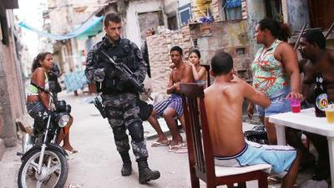
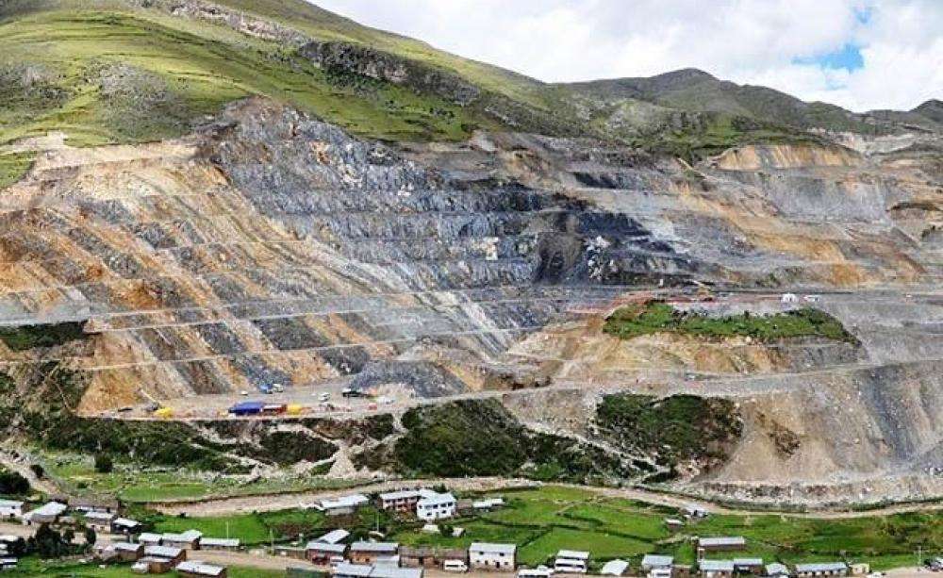
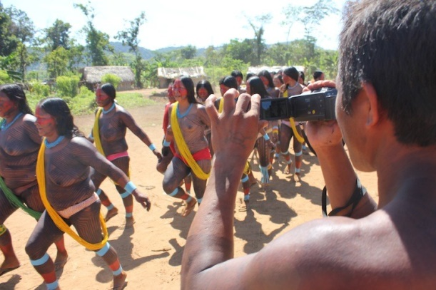
MLAS Program
Interdisciplinary perspective
Multiple research fields
Multicultural
Small-scale: ca. 20 students
Tailor made courses: tutorials
Broad LAS network
CEDLA: Community-oriented

Slide 3
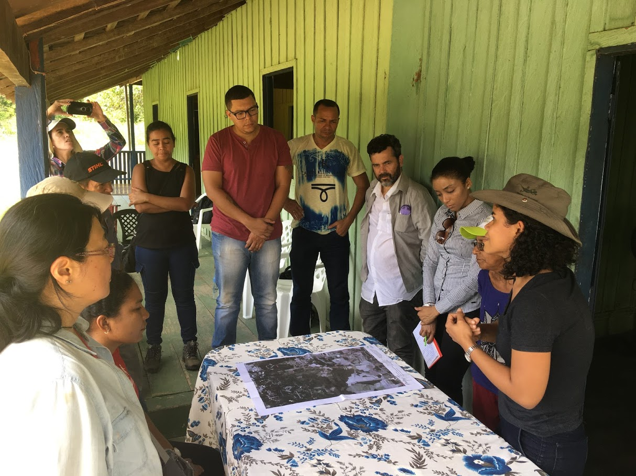
Research-driven
Research project
Fieldwork experience
Possibility to join CEDLA research projects
Multiple research seminars
Interaction with PhD students
LASP: preparation for PhD program

Slide 4
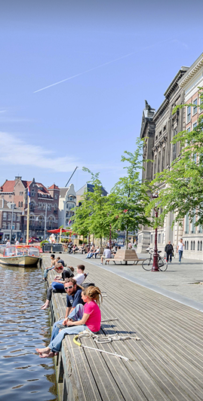
Career prospects
Academic Jobs
NGOs
Governmental agencies
Private business
Consultancy
Media
Own business

Slide 5
MLAS at a glance – Semester 1
Block 1 (Sept-Oct) | Block 2 (Nov-Dec) | Block 3 (Jan)
Latin American Studies: A Multidisciplinary Approach (6 EC) | Socio-Environmental Changes in Latin America: Power, Participation and Governance (6 EC) or Approaches to Popular Culture in Latin America: Researching Heritage and Worldmaking (6 EC) | Elective (6 EC)
Latin American Studies: Deepening the Debates (6 EC) | Interdisciplinary Methods (6 EC)

Slide 6
MLAS at a glance – Semester 2
Block 4 (Feb-March) | Block 5 (April-May) | Block 6 June
Fieldwork Report 1 (6 EC) | Fieldwork Report 2 (until mid April, 6 EC)
 | Master’s Thesis (with thesis seminar, 18 EC)

Slide 7

Admissions Advanced Master’s Programme
Entry requirements:
MA degree in Social Sciences/Humanities
Sufficient knowledge of English and Spanish/Portuguese
BA students in Social Sciences/Humanities or MA students with a different background → research proposal
Deadline: 1 May (or 1 April for housing)

Slide 8
Pre-masters Latin American Studies
For students with a degree from a Dutch university of Applied Sciences (HBO) or an equivalent thereof
More information: www.uva.nl/premaster-fgw

Slide 9
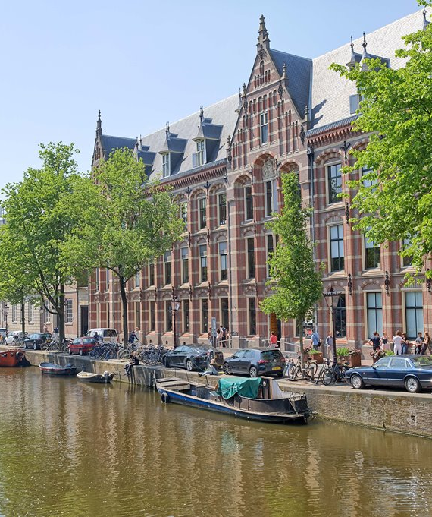
Tuition fee
3000 euros per year for all students (regardless of nationality, 1st or 2nd Master degree)
1000 euros CEDLA travel grant

Slide 10
Questions?
Contact:
Bente van de Nes at secretariat@cedla.nl

