Slide 1



Research MA Literary Studies
18:00
UvA Master’s Day
Dr Daan Wesselman, Dominique Ubbels, 7 Nov 2022

Slide 2



Why do Literary Studies?
To study literature as a cultural object
  Sure – but there’s more to it
Literature = area for studying questions of representation
  Narratives, metaphors, discourses

Slide 3

Research focus
Some recent thesis titles:
Naiveté in the Novels of Hans Fallade: Kleiner Mann - Was Nun?, Wolf unter Wölfen and Der Trinker
(Dis)Orientating Dirt: Investigations into a Metaphor in a Colonial and Post-Colonial Context
Entanglements of Time, Species, and Affect(s) in Richard Powers’ The Overstory (2018) and their Relation to Contemporary Climate Action
Androgyny: An Intersection of Daoism, Buddhism and Science Fiction
Every Book is a Community Event: Bibliodiversity and Contemporary Czech Children's Book Publishing
The Non-Authentic Identity of a Virtual Instagram Influencer: @lilmiquela’s Profilic Narratives and User Response

Slide 4

Why do Literary Studies?
Literature can serve as a way of thinking about, or “lens” on socio-political questions.
Examples that structure the Key Debates core course this year
  How Do We Read: Close, Thin, Deep, Distant, Hyper, Machine?
  What does it mean to decolonize literary studies and how can we do it?
  Is there literature without the human?
  Is critique damaging literary studies and if so, what should we do instead?

Slide 5
Research Master Literary Studies @ UvA
One of the most elaborate literature rMAs in the Netherlands
  36EC in core courses that focus on key debates, contexts and ways of doing research
  The rest: freedom to pursue your own research interests: you decide the content of 70% of the programme
3 paths in mind:
  Thematic (e.g. cultural memory, gender and sexuality, decoloniality)
  Language-based (Dutch, English, French, German, Italian, Spanish, Scandinavian and Slavonic)
  Period-oriented (Early-Modern, 19th C., contemporary)
Strong research environment (OSL, ASCA)

Slide 6
Research Master Literary Studies
Year 1 Study plan |  | Year 2 Study plan
Semester 1 | Semester 2 | Semester 1 | Semester 2
Key Debates in Literary and Cultural Studies (12EC) | Literature, Context, Historicity (12EC) | Literary Studies Lab (12EC) | Thesis (18EC)
Electives (12EC) | Electives (12EC) | Electives (6EC) | Research project (12EC)
 |  | National research school (6EC)
National research school (6EC) | Tutorial (6EC) | Tutorial (6EC)

Slide 7
Programme
Electives (just a selection within the Literary Studies cluster)
  Cultural Memory and Trauma
  Bodies and the Post-Human
  Contested Realities: Debating the Novel
  Narrative and Globalisation
  Il/literacy Matters: Thinking the Arts, Media, and Humanities in the 21st Century
  Shakespeare, Sexuality, and Adaptation
  Self-Reflection in Modern English Poetry
  Crimen y crisis: la novela detectivesca como respuesta a tiempos difíciles
  Surréalisme et littérature
  Modernisms and Avant-Gardes in Europe
  Contemporary European Literature: The Postmodern Detective
  Crisis and Alternative Languages in Literature and Art: Greece, the Mediterranean and Beyond
  Exile in Slavic Literature: Nabokov, Kundera, Milosz
  Internship

Slide 8
Programme
Tutorials (2x6EC): customized teaching, individually/small groups
  Specialization, close to ongoing research
National research school seminars & events (12EC in total)
  Events, workshops, conferences, winter schools etc.
  E,g, at the Netherlands Research School for Literary Studies (OSL), Netherlands Institute for Cultural Analysis (NICA), Netherlands Research School for Gender Studies (NOG)

Slide 9

Skills
You become:
A highly qualified researcher
A self-sufficient professional with strong analytical abilities
An expert on meaning, language and text
Used to intellectual labour, focused on new knowledge
Capable of making complex knowledge accessible to peers and to others
Career in academia
  Recent graduates: PhD positions at e.g. Cambridge University, UC Santa Barbara, Radboud (Nijmegen), Wuhan University, KU Leuven
Career in the cultural sector
  Recent graduates: Publishing / editor, policy/communications advisers, teaching

Slide 10
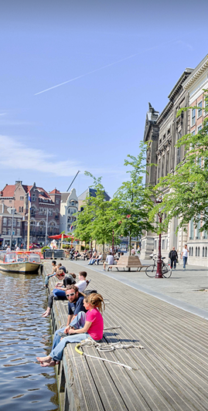
Programme: some numbers
Between 12-20 students
Situation in recent years:
  Around 35-40 applicants per year
  Meeting criteria => acceptance
Staff: 9 teach core courses (3x3), around 20 staff members closely associated with programme across departments – but you have access to the entire Faculty of Humanities

Slide 11
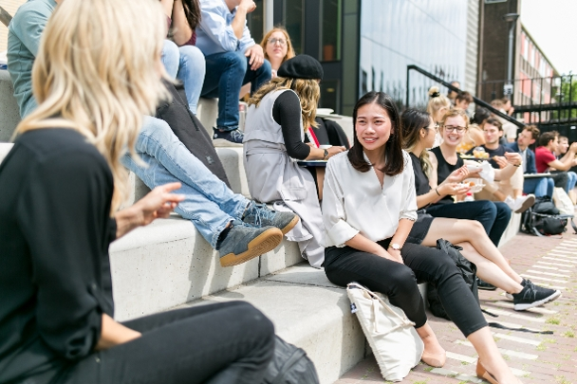
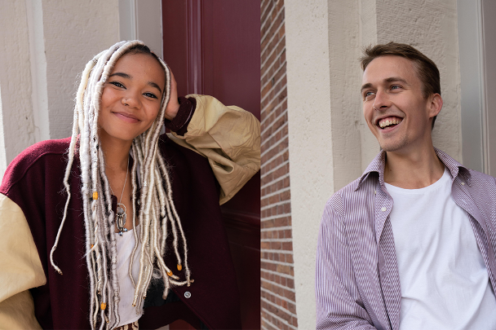

Student perspective
Dominique Ubbels (2nd year)
What made you decide to apply for this RMA programme at the UvA?
What are the courses like?
What is studying like within this programme? Study load?

Slide 12

Admissions
Entry requirements:
A relevant BA degree in (e.g. Literary Studies, Comparative Literature, Language & Culture, or other pertinent Humanities degree)
  Demonstrable affinity with research in Literary Studies
Motivation letter + study plan
  Concrete: what research interests, what path do you see for yourself, what courses
English proficiency: reading, writing, speaking.
See gsh.uva.nl for further details
Apply before March 1, 2023
  Also important if you need to arrange housing
  “Transfer” possibility from 1-year MA: in January, same criteria for selection
    Courses from 1-year programme can be used for elective space
Specific questions about application and admission
uva.nl/questionform

