Slide 1
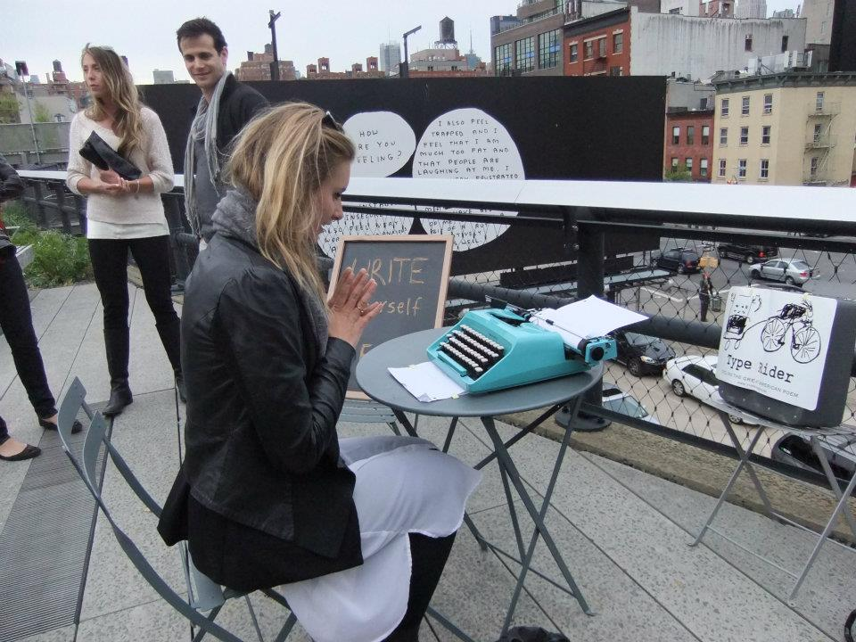
Information Session – 20 November 2023
Art and Performance Research Studies
Julia Kursell (academic specialism) & Kasia Lech (Artistic Research specialism)

Slide 2
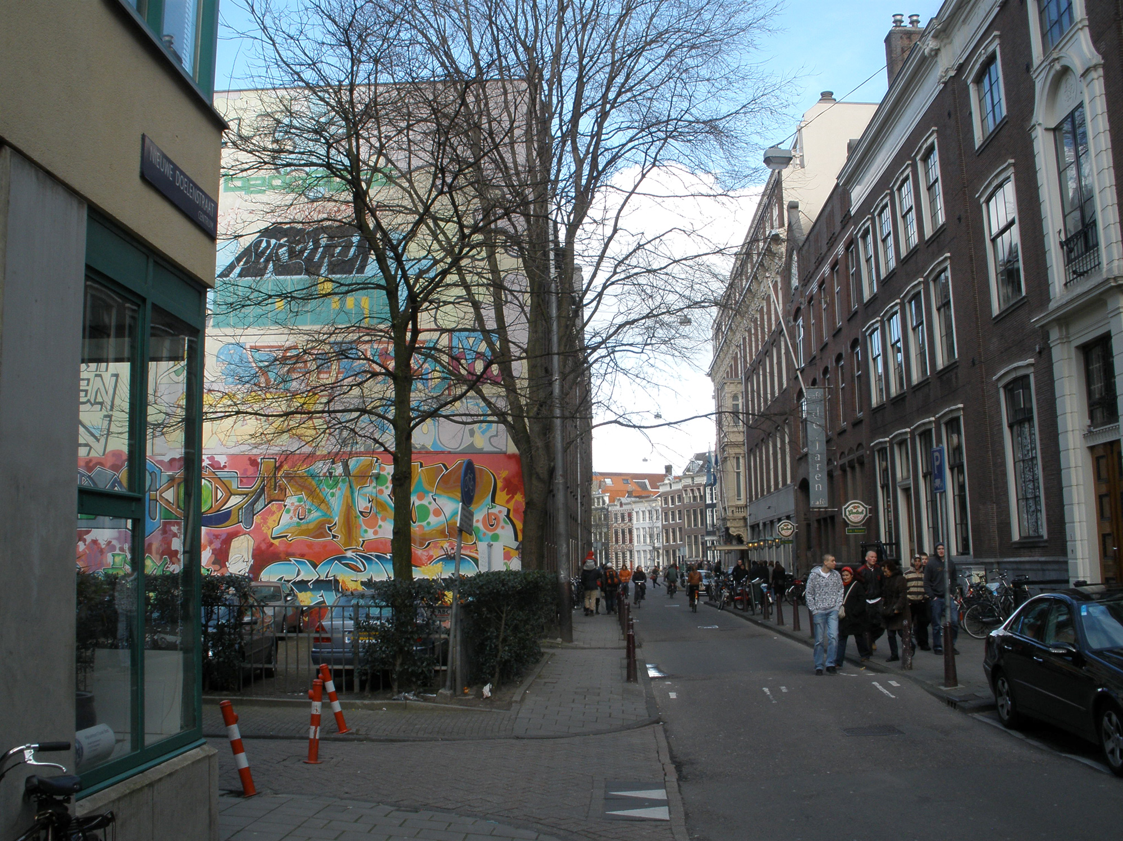
Our plan for this session
  Who are we?
  Art & Performance Research Studies
  Student Profiles
  Study Programme(s)
  Student Experience
  Wrap up & Questions

Slide 3
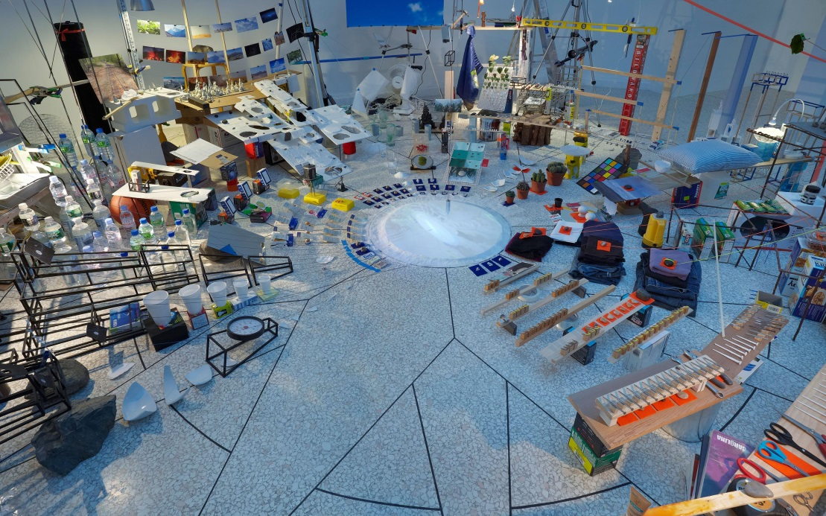
Art & Performance Research Studies at the UvA
Two-year program that prepares for pursuing research as a PhD candidate – but not only
Comprises two specialisms – Art and Performance Studies and Artistic Research with slightly different programs of study
Is embedded in a country-wide landscape of research and art, including music, performance and theatre and the visual arts

Slide 4
Art & Performance Research Studies at the UvA
Two-year program that prepares for pursuing research as a PhD candidate – but not only
Comprises two specialisms – Art and Performance Studies (APS) and Artistic Research (AR) with slightly different programs of study
Is embedded in a country-wide landscape of research and art, including music, performance and theatre and the visual arts

Slide 5
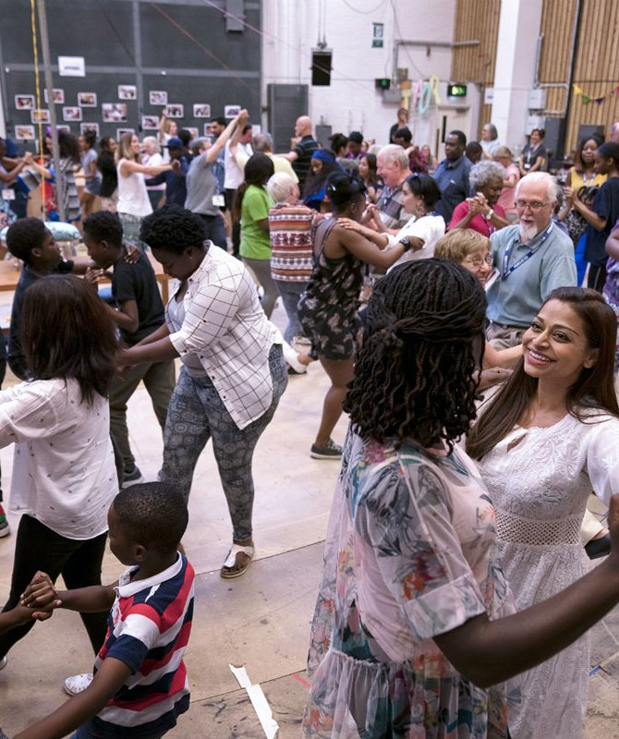
As a student in the Master’s programme in Art and Performance Research Studies
… you are interested in …
inter-, intra- and cross-disciplinary themes and propositions,
in an active dialogue between art theory and art practice,
and in the role of the arts within society.

Slide 6
Unique combination of …
Interdisciplinary
offers comprehensive cross-disciplinary debates with expert staff from all art disciplines, both theoretical and practical research in mixed student groups
Interacademic
engenders debate and reflection on theory and practice by offering three shared core courses, bridging art and academia
International
opens the possibility to execute (part of) your research abroad (archives, institutions, participatory) if your research plan requires it

Slide 7
Our program
Central to the program is that students …
learn how to work as autonomous researchers
reflect on and learn to carry out research in an inter- and cross-disciplinary framework and to understand the position of the arts and the artist in society
get individual support to develop their path of research regarding their own interests.

Slide 8
Our academic year
Two semesters:
  September–January and February–June
  divided into
  - two periods of 8 weeks each (Sept/Oct; Nov/Dec; Feb/Mar; Apr/May)
    1 week without teaching activities (but do check individual course information!)
    6 weeks of teaching
    1 exam week (including time for, e.g., finalizing papers and essays)
  - one period of 4 weeks (January; June)

Slide 9
Core Courses
The first core course focuses on disciplinary backgrounds and shared themes and debates in the arts; during the course you learn how to formulate a research proposal for your project.
The second core course focuses on how to carry out the actual research, e.g. by consulting collections and archives in a historical and theoretical perspective, and on the arts as a field of knowledge (production); during the course you practice specific research skills and report on the findings in a professional way.
The third core course discusses contemporary concepts and practices, enabling you to sharpen your arguments and to position your research within the contemporary academic and artistic research field.

Slide 10

2 years, 2 specialisations
APS: focuses on theoretical and historical research in academic disciplines such as art history, musicology, theatre and performance studies, cultural studies
AR: focuses on artistic research through a practice-based process in fine arts, dance, music, performance and film, among others

Slide 11
APS (academic) Student profile
You have a Bachelor’s degree from an accredited university and have taken academic courses equivalent to at least one full-time semester of academic studies (30 ECTS) in Art History, Musicology, Theatre or Performance Studies, Cultural Studies.
You are able to set up and conduct research and know how to formulate consistent research questions, collect and select material, apply theory, plan, structure and write a thesis.
You are familiar with contemporary theoretical/methodological debates within your original discipline.

Slide 12
Artistic Research Student profile
You have a Bachelor's degree from an Arts Academy or accredited university with a focus in the Arts/Culture, such as Art History and Curatorial Studies.
You have an autonomous practice as an artist.
You are acquainted with techniques, methods, processes and practices appropriate for your field.

Slide 13
Elective Courses
APS (academic specialism)
Whatever your home discipline, you have full access to specialized MA courses in Art, Music and Theatre studies!
The courses you may fill in according to your own interests are the greatest share (84/120) of the credits in the academic specialism:
    30 (electives)
    12 (tutorials)
    12 (research school activities)
    30 (thesis)

Slide 14
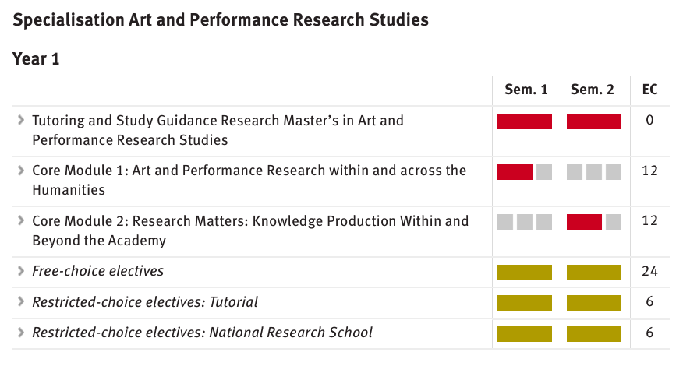
During your studies – the program(s)
Academic Specialism “Art and Performance Studies”
Afbeelding invoegen

Slide 15
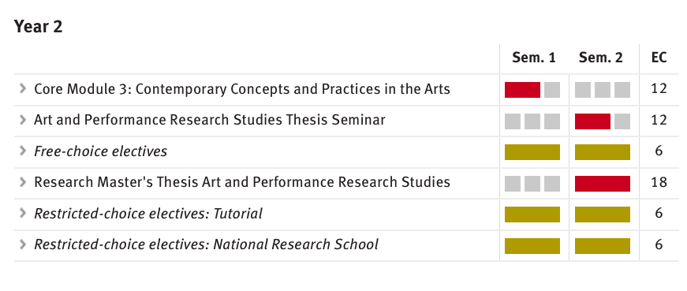
During your studies – the program(s)
Art and Performance Studies Specialism
Afbeelding invoegen

Slide 16
During your studies – Tutorials: immersing yourself in research
Afbeelding invoegen
“Tutorial” describes, ideally,
a 1:1 research situation:
you choose with whom to work
and what to work about
You can do so maximally twice during the entire program.
NB:
The tutor or program coordinator can help you in choosing and arranging a tutorial.
Tutorials might require a different timing than the one indicated in the course catalogue!

Slide 17
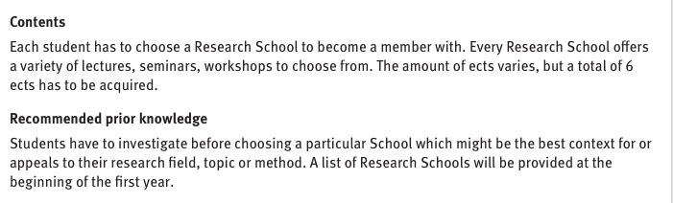
During your studies – Tutorials and National Research School Credits
Afbeelding invoegen
The program comprises 12 ECTS from so-called National Research Schools.
A list of the relevant institutions can be found here:
https://aihr.uva.nl/national-research-schools/research-schools.html
Example: The OSK – currently organized by the UvA and headed by Dr. Rachel Esner
Other popular options: NICA, Huyzinga

Slide 18

Artistic Research Specialism
Afbeelding invoegen

Slide 19
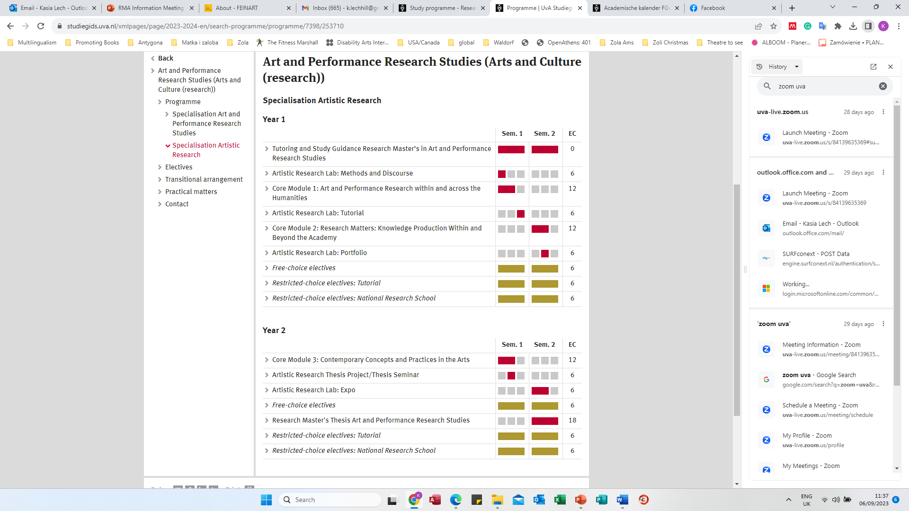
During your studies – the program(s)
Artistic Research Specialism
Afbeelding invoegen

Slide 20
During your studies – the program(s)
Artistic Research Specialism
Afbeelding invoegen

Slide 21
During your studies Artistic Research Lab
Integrating your creative practice and academic research
Afbeelding invoegen
Year 1
Year 2
NB:
Some Artistic Research modules might require a different timing than the one indicated in the course catalogue!

Slide 22
During your studies – Tutorials: practicing how you integrate your practice into research
Afbeelding invoegen
Year 1
“Tutorial” describes, ideally,
a 1:1 research situation:
you choose with whom to work
and what to work about
You can do so maximally two times during the entire program.
Year 2
NB:
The tutor or program coordinator can help you in choosing and arranging a tutorial.
Tutorials might require a different timing than the one indicated in the course catalogue!

Slide 23
During your studies –
National Research School Credits
Afbeelding invoegen
Year 1
All of you must obtain 12 ECTS from so-called National Research Schools.
A list of the relevant institutions can be found here:
https://aihr.uva.nl/national-research-schools/research-schools.html
Consider your interests as well as your art form(s). What is it that you are exploring? Gender? Labour? Wellbeing?
Examples: NOG, POSTHUMUS, OZSW
Year 2
Each student has to choose a Research School to become a member with.
Every Research School offers a variety of lectures, seminars, workshops to choose from. The amount of ECTS varies, but a total of 12 EC has to be acquired.
Students have to investigate before choosing a particular School which might be the best context for or appeals to their research field, topic or method.
NB:
Registering National Research School credits goes through the examinations board of the Graduate School of Humanities.
Credits from the NRS can also be registered as electives!

Slide 24
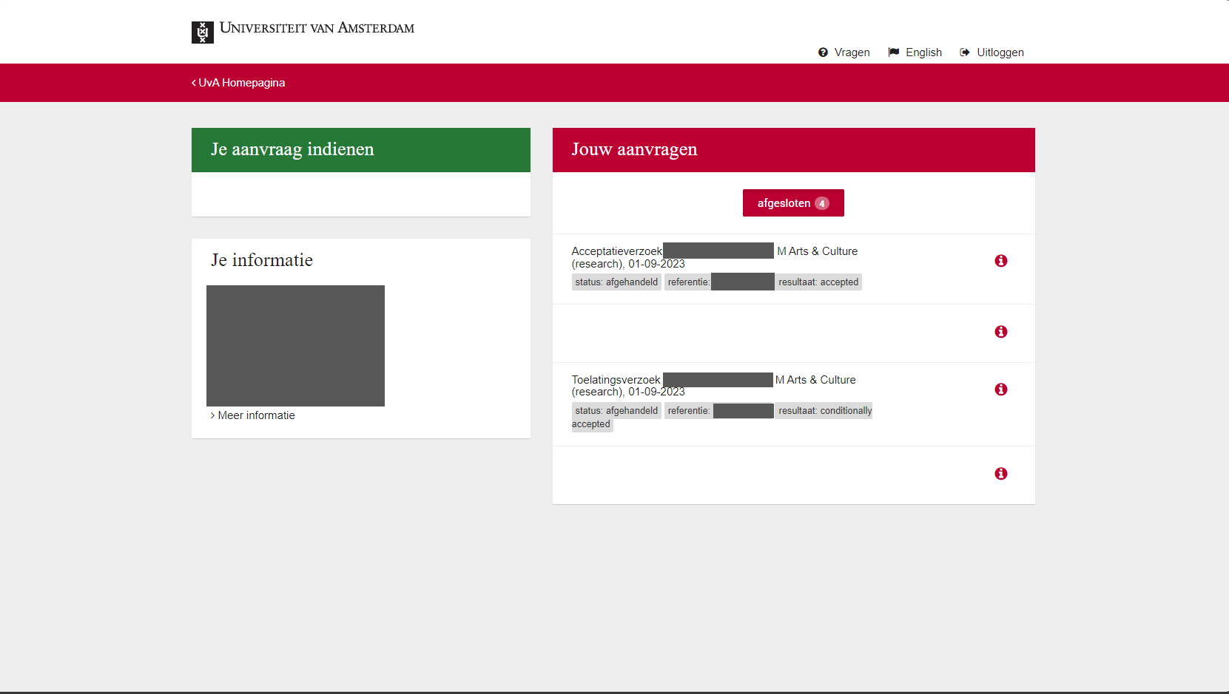
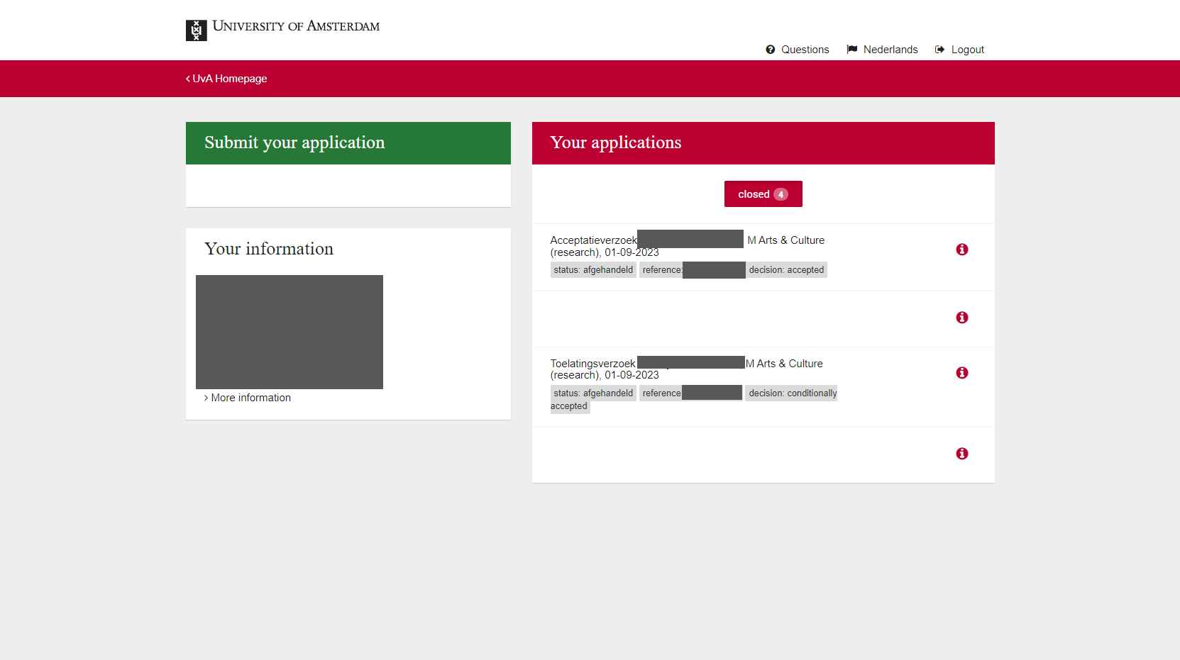
Applying for Art & Performance Research Studies at the UvA

Slide 25
Applying for Art & Performance Research Studies at the UvA
CV curriculum vitae;
Proof of language proficiency;
Transcript of records, up-to-date and issued by your home institution (if you are already a student at the UvA, a screenshot from SIS is sufficient);
Diploma (if already obtained)* or list of courses yet to complete;
translation of your diploma and transcript of records (if they are not in English, Dutch, German or French);
motivation form (PDF);

Slide 26
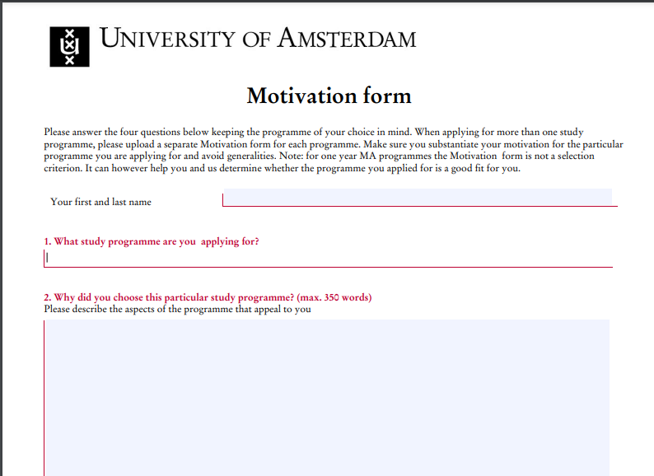
Important issue
Please clearly state whether you are applying for the Art and Performance Studies or Artistic Research specialisation in your motivation letter.

Slide 27

Applying for Art & Performance Research Studies at the UvA
Applying for Art and Performance Studies Specialism
  A sample of academic writing written in English.
Applying for Artistic Research Specialism
  A sample of academic writing written in English;
  A portfolio of realised artwork or art-related projects.
  Please combine them in one file.
  Interview

Slide 28
Applying for Artistic Research Specialism: Portfolio
A pdf with images or videos or links, or an online portfolio, or a website.
Who you are as an artist and what your practices are?
What is your artistic vision for these works and in what context(s) they have been exhibited/performed?

Slide 29

During your studies
Quality of Education
  Programme Committees
  Evaluations
  Examination Board
Support
  Tutoring (Academic advice)
  Study advisors

Slide 30
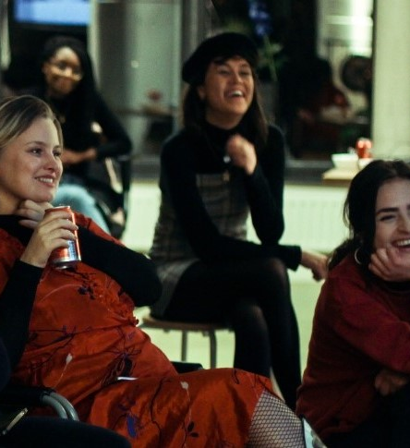
Extracurricular activities
VOX-POP: the ‘creative space’ of the Faculty of Humanities, connecting the world of the university to the city.
CREA: cultural organisation of the UvA organising courses and workshops.
USC: the university sports centre of the UvA

Slide 31
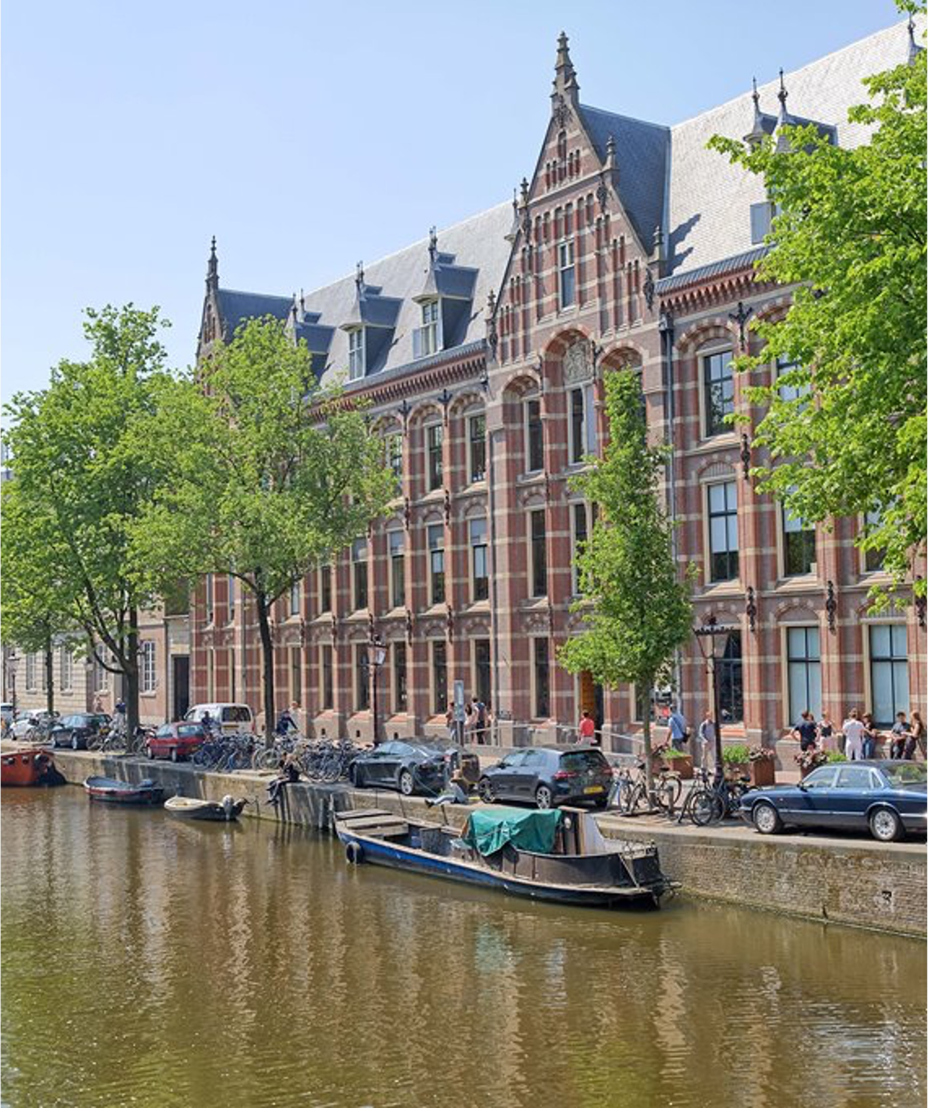
Deadline
1 March 2023
All applicants: both AR and Academic; EU and non-EU
For deadlines concerning housing and funding, please check the website of the admissions office.

Slide 32
Important websites/pages
Programme website: https://www.uva.nl/en/programmes/research-masters/art-and-performance-research-studies/art-and-performance-research-studies.html
UvA admissions: https://www.uva.nl/en/education/admissions/admissions.html

Slide 33

Thank you. Any questions?

