Slide 1
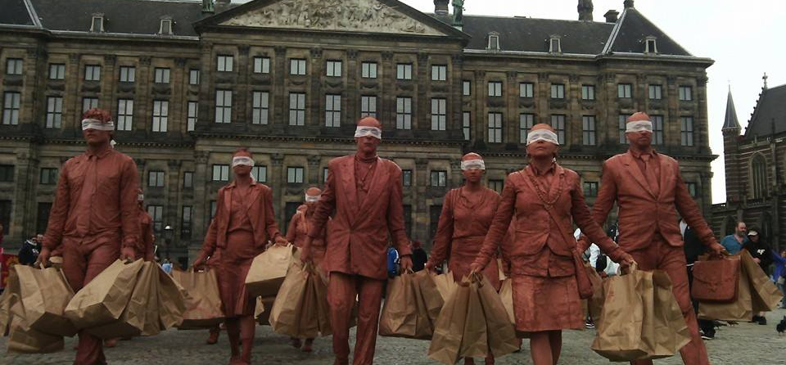


MA Theatre Studies
16:00
UvA Master’s Day
Sruti Bala – MA Co-Ordinator, 09 Nov 2022

Slide 2
Main Features of MA Theatre Studies
One-year intensive or two-year part-time programme
Opportunities for developing individual research specialisations
Profile areas:
performance studies, musical theatre and opera, theatre and society
Participation in research seminars and talks to broaden your disciplinary horizon
Benefit from intensive group mentoring and an individual dissertation supervision trajectory

Slide 3
Programme structure
The year is split in two semesters, each of 30 EC
Each semester consists of three teaching periods (blocks). The first two blocks are 7 weeks, the third block is 4 weeks.
Students have core courses and electives (per semester one)

Slide 4
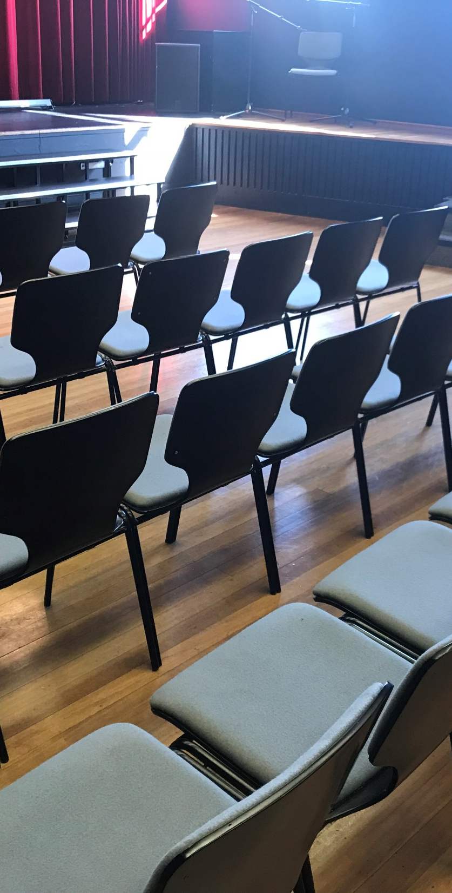
Study programme
Modules | Sem 1 |  |  | Sem 2 |  |  | EC
Key Concepts and Methodologies in Theatre and Performance Studies (core module) |  |  |  |  |  |  | 12
Restricted-choice electives (18 EC)
Archiving Art |  |  |  |  |  |  | 12
Theatre and Globalisation: Acts of (In)Justice in Contemporary Theatre and Performance |  |  |  |  |  |  | 6
Spectatorship and Education: Researching Audiences |  |  |  |  |  |  | 6
Free-choice electives (12)
Art and Activism |  |  |  |  |  |  | 6
Music Theatre as a Laboratory |  |  |  |  |  |  | 6
MA Thesis (incl winter school) |  |  |  |  |  |  | 18
Credits (total) |  |  |  |  |  |  | 60

Slide 5
Electives
Theatre/performance in relation to societal transformations: globalization, spectatorship and education, art and activism
Historiography/Documentation: archiving the arts
Performance analysis: music theatre as a laboratory, globalization
Internship
Can be chosen instead of an elective for 6 EC
Placements need to be planned in discussion with MA coordinator
Internship graded with pass/fail
Examples: archival work for theatre company; organizing panel discussion at festival; outreach activities for production tour

Slide 6
MA thesis (Examples of dissertation titles from recent years)
A Failed Transition? Culture’s Tragic Turn and the Discourse of the Post-communist Transition: The Echo of the Alternative Movement of the Eighties in Slovenia’s 2020 Anti-government Movement
An investigation of Virginia Woolf’s Orlando based on Gender Performance and Trans Theory
“Ach, was ik maar een kleine zwakke vrouw”: De ondermijnende potentie van cabaret door vrouwen
Crisis as Inhibitor and Catalyst: Responses from Theatre Collectives in Athenian Neighbourhoods
Redressing Historical Pain, Trauma and the Stereotyping of the Moluccan Community in the Netherlands: An ethnographic study of the performance Een Tijdelijk Verblijf, first part of the triptych theatre project Aan De Andere Kant.

Slide 7
Core Teaching Faculty and Potential Thesis Supervisors
Prof. dr. Kati Röttger: Performance Theories, Image Critique, Intermediality, Technologies, Gender
Prof. Dr. Nicholas Till, Pierre Audi Special Professor of Music Theatre and Opera
Prof. Dr. Millie Taylor, Joop van den Ende Special Professor of the Musical
Prof. Dr. Gabriele Klein, National Opera and Ballet Special Professor of Dance Studies
Dr. Kasia Lech: Dramaturgy, Multilingual Performance, Theatre Historiography
Dr. Sruti Bala: Performance Studies, Participatory Art, Feminist and Postcolonial studies
Dr. Veronika Zangl: Humour, Memory Studies, Cabaret/Amusement, Dutch theatre texts
Dr. Rob van der Zalm: Dutch Theatre History, Curation
Dr. Cock Dieleman: Theatre and Education, Contemporary Dutch Theatre
Dr. Mele Yamomo: Opera, Postcolonial studies, Sound studies
Dr. Lisa Skwirblies: Theatre Historiography, Postcolonial studies, Dramaturgy
Ricarda Franzen MA: Dramaturgy, Music theatre/ Sound studies

Slide 8
Career prospects
Education staff member with theatre companies, theatre or festivals
Programmer/Curator
Policy advisor with governmental or cultural organizations
Art educator
Editor or journalist with newspapers, periodicals, radio or television
Critic
International cultural exchange
Cultural activist/worker
For Dutch-speaking students: upon completion of one-year MA there is a possibility to gain an additional teacher’s training qualification at ILO (master Leraar Voorbereidend Hoger Onderwijs)

Slide 9
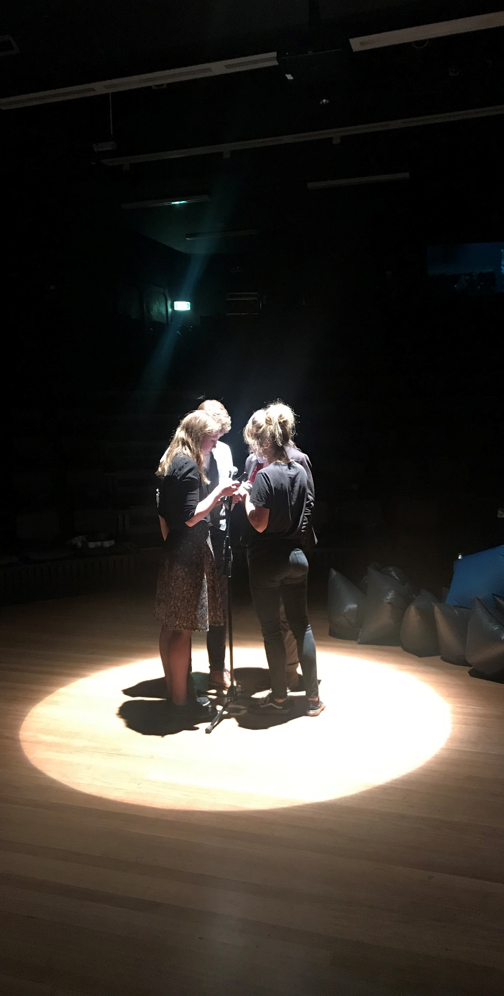
Admissions and pre-masters
Entry requirements
Generally: a Bachelor’s degree from an accredited university in the humanities or social sciences with a minimum of 30 ECTS (equivalent to a full-time semester of academic studies) taken in the field of theatre, drama or performance studies.
Pre-masters (in Dutch)
For those of you who do not meet the criteria, but have a Dutch applied university degree (HBO), for example, you can follow a pre-masters programme by following Bachelor courses
30 EC / 42 EC pre-master (in Dutch) :
Semester 1
Academic Skills 1 (12 EC, blok 1 & 3)
Inleiding in de theaterwetenschap (12 EC, blok 1 & 2)
Semester 2
Wetenschapsfilosofie (6 EC, blok 1)
Performance Analyse (12 EC, blok 2 & 3)

Slide 10
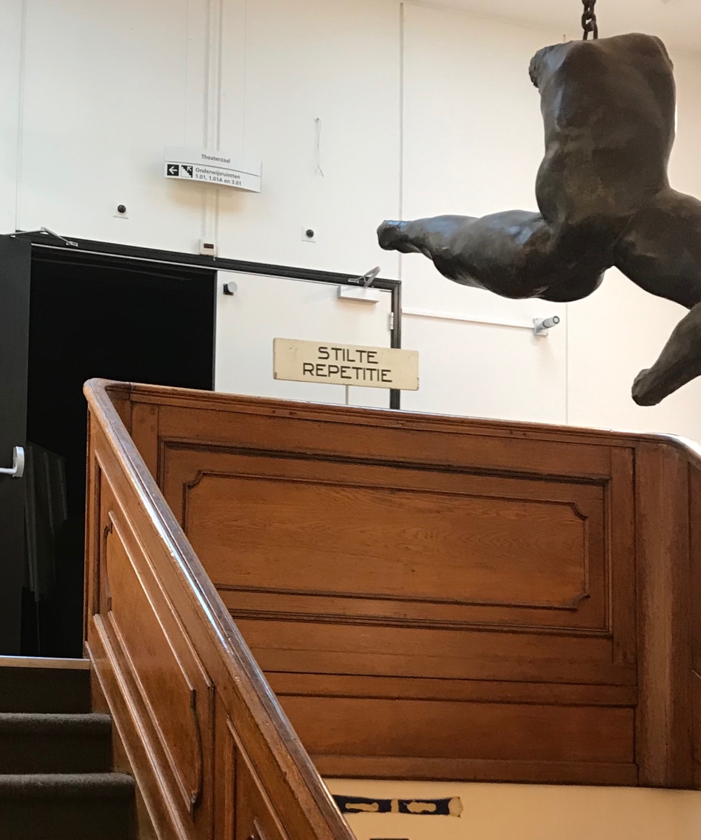
Deadlines
Applicants with a non-EU/EEA nationality
1 March 2023
Applicants with a Dutch or other EU/EEA nationality
15 May 2023
Please note: if you are an applicant with an EU/EEA nationality and wish to apply for housing, you must submit your application by 1 March.
If you are interested in a scholarship, you need to apply for both the Master's programme and the scholarship before 15 January. Learn more at:
https://gsh.uva.nl/fees-funding/scholarships/scholarships.html

Slide 11
Contact
Specific questions about content and study planning
s.bala@uva.nl
Questions about formal aspects of application and admission
mail to: AdmissionsMA-fgw@uva.nl

