Slide 1



Stakeholder Involvement in “other sectors” introduction to session 7,
19 January
Maarten Wolsink
NEA Workshop on Stakeholder
Involvement
in Nuclear Decision-Making
Paris, 17-19 January, 2017
Department of Geography,
Planning & International
Development Studies University of Amsterdam

Slide 2
“Stakeholder involvement in other sectors”
Session with 3 talks:
HV Transmission lines
CCS; Carbon-Capture-Sequestration/Storage)
‘Common misconceptions’, reviewing all energy infrastructure
Starter: conclusion #1 on misconceptions:
Looking at other power supply infrastructures is not looking at ‘other sectors’

Slide 3
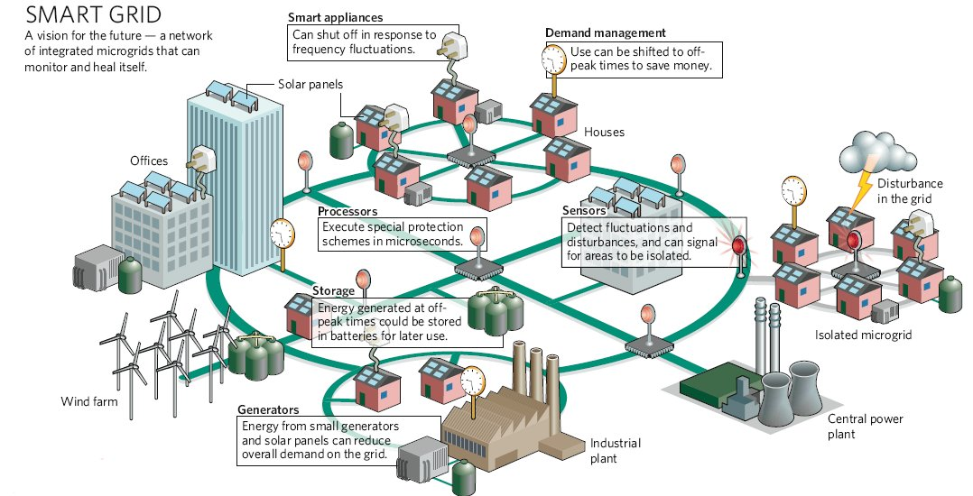
Future ‘intelligent’ grid: integrating variable sources, numerous units in varying geographies, integrated with highly varying demand

Slide 4
Contrasting 2 perspectives:
I. Instrumental consultation
Avoid ‘consultation’ with stakeholders unless ..
There is recognition that public/ stakeholders provide necessary information
Social acceptance necessary and unlikely without involvement
Thomas 1993 Administration & Society 444-469

Slide 5
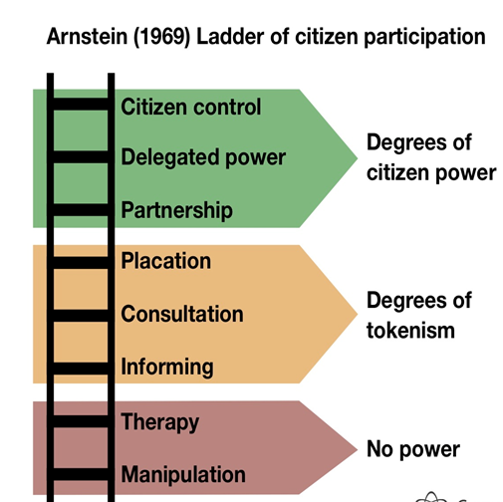
Contrast 2 perspectives:
II Engagement is participation

Slide 6
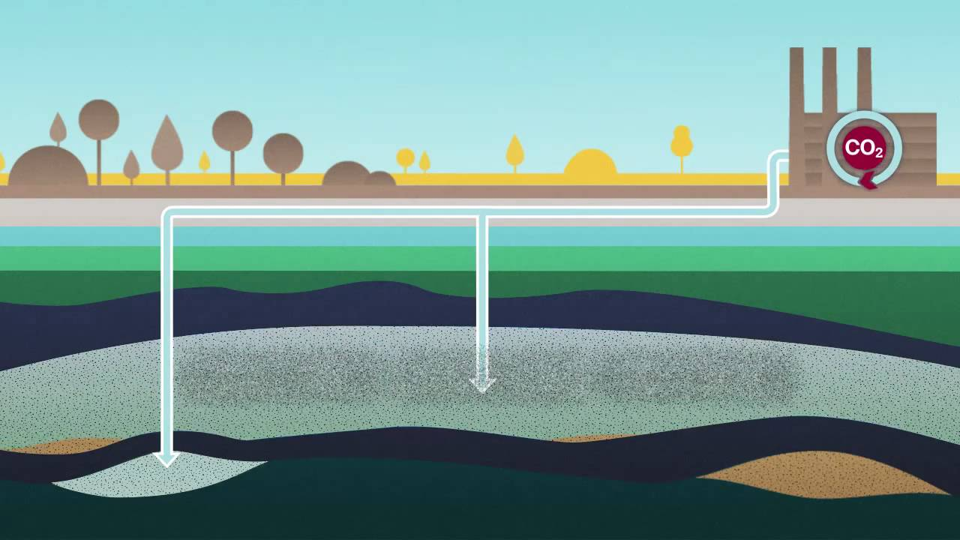
Speaker:
François Kalaydjian
IFPEN: IFP Energies nouvelles (Paris, F).
Research on energy, environment and mobility
Deputy Director of the Resources Business Unit
In charge of several research programs,
for example on CO₂ capture and storage
CCS
CO₂ Capture
& Storage

Slide 7
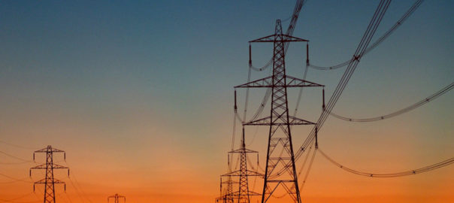
1st Speaker:
Nadejda Komendantova
International Institute for Applied System Analysis
(IIASA); Laxenburg, Austria
Reseacher and coordinator of the theme “Governance in transition” within the Risk and Resilience Program
ETH: Federal Institute of Technology;
Zürich, Switzerland
High Voltage
Transmission
Lines

Slide 8
Common misconceptions on stakeholder involvement –
Reviewing deployment of RES
NEA Workshop on Stakeholder Involvement
in Nuclear Decision-Making
Paris, 17-19 January, 2017
Maarten Wolsink
Department of Geography,
Planning & International
Development Studies University of Amsterdam

Slide 9

A ‘must read’ on the STS of the US grid
The electricity grid is
"a machine, an infrastructure, a cultural artifact, a set of business practices, and an ecology………
…..designed for the exact opposite of 21st-century needs.”

Slide 10
‘Smart grid’: “…rescaling and distributed generation” … “integrated micro-grids that can monitor and heal itself”
Marris 2008, Nature 454, 570

Slide 11
Power supply system is an STS
“Socio-Technical System”
Instead of current centralized STS, many new elements with socially fully different characteristics
Wolsink, 2012. Renewable Sust Energy Rev 16, 822-835.
Renewables, much “Distributed Generation”
• Micro/decentralized
• spatially dispersed
• variable supply (often directly to local demand)
Infrastructure for “intelligent grid”
Charles D 2009 Science 324: 172-175 "Renewables test IQ of the grid"
Spatial claims renewables’ infrastructure "huge"
MacKay DJC 2008. Sustainable Energy – without the hot air. UIT Cambridge.

Slide 12
Distributed Generation sample, taken from Ackermann et al., 2001; Wolsink, 2017
Combined cycle gas T. 35–400 MW
Internal combustion engines 5 kW–10 MW
Combustion turbine 1–250 MW
Micro-Turbines 35 kW–1 MW
Renewable ( favourable, but ≠ ‘sustainable’)
Biomass, e.g. gasification 100 kW–20 MW
Small hydro 1–100 MW
Micro hydro 25 kW–1 MW
Wind turbine 200 Watt–3 MW
Photovoltaic arrays 20 Watt–100 kW
Solar thermal, central receiver 1–10 MW
Solar thermal, Lutz system 10–80 MW
Fuel cells, phosacid, molten carbonate 200 kW–2 MW
Fuel cells, proton exchange 1 kW–250 kW
Fuel cells, solid oxide 250 kW–5 MW
Geothermal 5–100 MW
Ocean deep water cooling 10-200 MW
Stirling engine (micro CHP) 2–10 kW

Slide 13
DG, continued
Ocean energy
Waves, Tidal 100 kW–1 MW
Saline/Fresh (osmotic) pressure 100 kW-50 MW
Distributed Storage and Transmission (of Renewable generated energy )
Heat storage (electric boilers) 1-10 kW
Heat storage in buildings (solar, electr. heat pumps) 10-500 kW
‘Cold’ storage (cooling systems) 1-100 kW
Battery storage 500 kW–5 MW
Electric vehicles (batteries) 10-100 kW
V2G (Vehicle-to-grid; uploading) 10-100 kW
MicroGrid (balancing supply-demand within) 1kW-100MW
SuperConducting Transmission lines 100-1000 kV
Storage in ‘non-heat’ consumption (of Renewable generated energy )
Water Supply systems 10kW-1000 kW
Desalinization reservoirs 10kW-500 kW
Pumped hydro 1-1000MW
Storage in CO₂ based fuels 10kW-1MW (??)
And many more emerging……

Slide 14
Conceptualization of
Social acceptance of energy innovation adapted from Wüstenhagen et al 2007, p.2386
Community Acceptance end users, local authorities, residents → project decision making on infrastructure, investments and adapted consumption; based on trust, distributional justice, fairness of process
Market Acceptance producers, distributors, consumers, intra-firm, financial actors → investing in RES-E and DG infrastructure, using RES generated power
Socio-Political Acceptance
regulators, policy actors, key stakeholders, public
→ craft institutional changes & effective policies fostering market & community acceptance

Slide 15
Some state-of-the-art fundamentals inconsistent with common sense
Social Acceptance ≠ Public Acceptance
Acceptance energy source ≠ Acceptance projects
Barriers to deployment NOT primarily local opposition
(community acceptance)
‘Information deficit model’ (public is ignorant; attitudes can be changed by campaigns; ‘education’ or ‘therapy’ is ‘engangement’) absolutely invalid
High deployment rates dependant on institutionalization (question of socio-politcal acceptance)
of stakeholder and public participation (in community acceptance and in market acceptance)

Slide 16
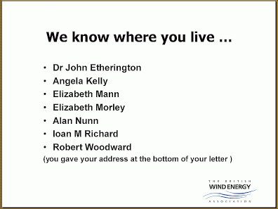
Attempts to avoid engagement:
→ frustration among developers and authorities;
→ accusations: selfishness, Nimby’s, ignorance
striking example: BWEA’s website (2007)

Slide 17
Attitude object: Power Supply with substantial amount of RES (e.g. wind, solar, tidal)
Essential characteristics
'Environmentally benign, renewable
Supply Characteristics
Visibility
Economics
Structure energy sector
Associated Attributes
Alternative to fossil
Alternative to nuclear
Source can't run out
Variability; Reliability;
Capacity credit;
Domestic source
Landscape impact turbines
Nature/wildlife; birds
Price (←→ alternatives)
Related to supply charact.
Impact industry, employment
Distributed; Decentralised
Small scale; Entrance new parties

Slide 18
Attitude object: RES project (wind, solar etc.)
Essential characteristics
Location and site
‘Project Owner’: Initiator – Investor – Manager
Wind/solar/tidal … power
Decision making process
Associated Attributes
Landscape identity; Annoyance; Nature/wildlife; Design; Competing spatial functions
Community in/outsider initiative Part of microgrid; Benefits local economy; Shareholders; Community identity; Demand;
Visibility; Clean – renewable; Supply characteristics
Open / closed; Community involvement; Public/stakeholder
participation;
Justice/Fairness: Distributive –Recognition - Procedure

Slide 19
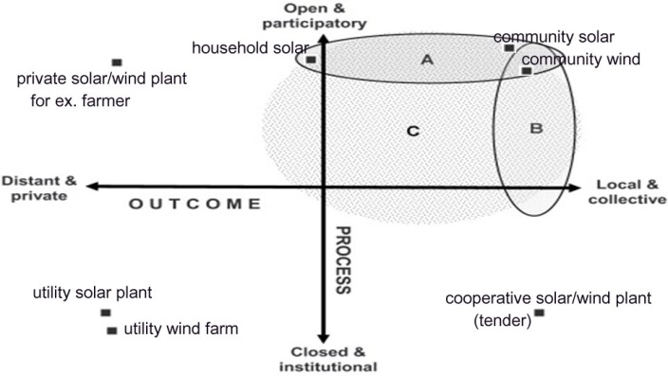
Involvement communities (examples) more participation → higher likelihood of success, distance & closed tends to generate distrust adapted, from Walker, Devine-Wright 2008 Energy Policy 36, 497

Slide 20
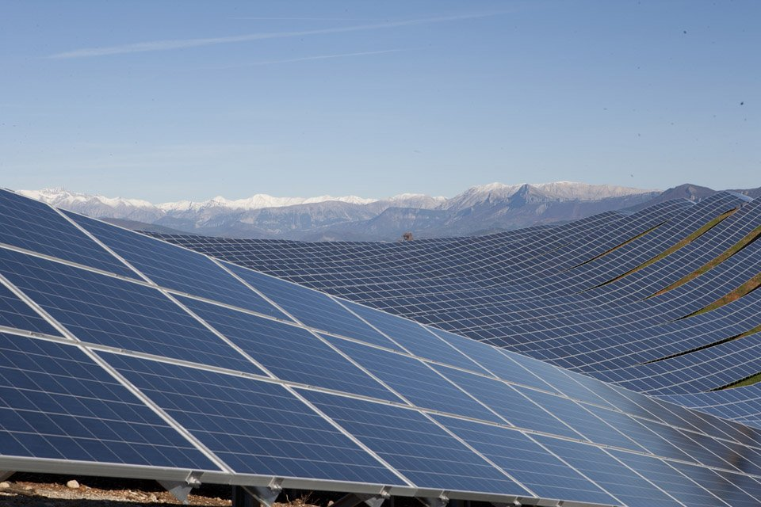
Centralized ‘utility-solar’
Les Mées, Alpes-Haute Provence (F)

Slide 21
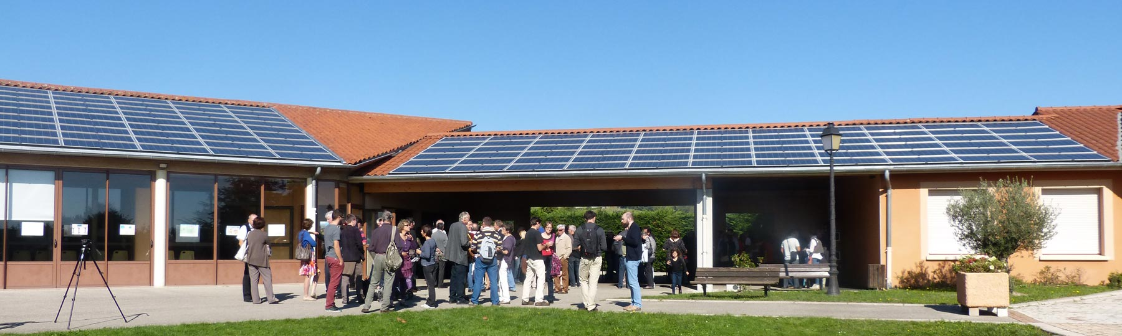
Centrale Villageoise Rosans
Hautes-Alpes (F)
Individual co-operative investors, municipality, Parque Regional des Baronnies-Provençale,
Rosans (+8 other communities)
392,4 m² solar panels rooftops on 9 buildings

Slide 22
‘Afsluitdijk’ near-shore Wind Power development IPWA 2003
278 MW
2 provinces
4 municipalities
Nuon (E-company; currently part of Vattenfall)
National government: ministries of
* Economic Affairs
* Housing, Spatial Planning & Environment
* Agriculture and Nature
No further societal stakeholders,
only an external advisory committee
typical example of ‘placation’

Slide 23
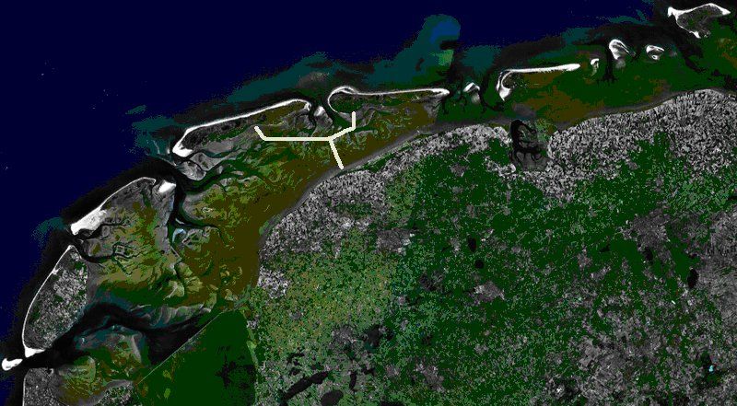
Foundation Wadden Union as opposition against infrastructure; Occasion: diking project in 1964

Slide 24
Acceptability locations: as perceived by members ‘Wadden Union’
Wolsink 2010, Land Use Policy 27 (2) 195

Slide 25
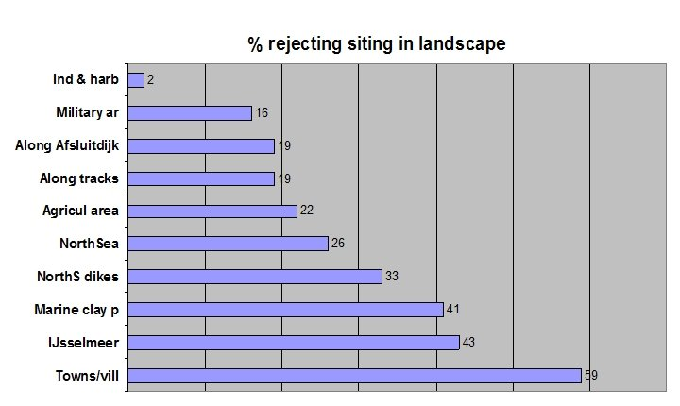
Acceptability locations: as perceived by members ‘Wadden Union’

Slide 26
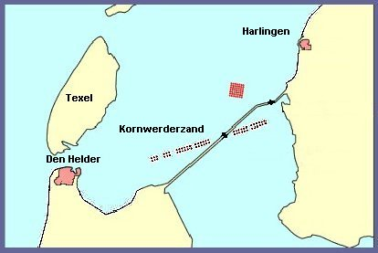
‘Decision’ by Government and project developer

Slide 27
Main trend:stakeholder participation can not be uncommitted : there is no free lunch
Any decision on energy infrastructure is always about a choice between alternatives
→ any project’s ‘public good’ is always challenged
It is more about socio-economical variables than technology
Distribution of costs-benefits:
▪ economic (financial, employment)
▪ and social (whose infrastructure; landscape change on sites with high ‘place attachment’)
Fairness of process (‘procedural’ justice)

Slide 28
Stakeholder perceptions on fairness of process
It must be clear who will bear the cost / perceived risk
→ most important: open for negotiation
Participation means: process openness, open-ended
● for all actors: ‘gate keeping’ (selection of stakeholders) is felt as manipulation
● for all arguments
● outcome must be open for change
→ ‘success’ could mean: other project, other site
No openness/open end: prepare for distrust and uncooperativeness (also in later projects)

Slide 29
Ladder of participation
Engagement cannot be non-committal
→ inclination towards tokenism and ‘therapy’
Most systems: Current reliance on ‘tokenism’, sometimes
Steps down the ladder:
•commodification RES projects (e.g. tenders)
•‘streamlining’ planning
hierarchical agenda
Cowell Owens 2006

Slide 30
Literature
Ackermann, T., Andersson, G. , Söder, L. (2001) Distributed generation: a definition. Electric Power Systems Research 57, 195–204
Arnstein, S.R. (1969) A Ladder Of Citizen Participation, Journal of the American Planning Association 35 (4) 216—224
Bakke, G. (2016) The Grid. The fraying wires between Americans and our energy future. New York: Bloomsbury.
Charles, D. (2009). Renewables test IQ of the grid. Science, 324,172–175.
Cowell, R., Owens, S. (2006) Governing space: planning reform and the politics of sustainability. Environment and Planning C 24: 403–421
Geels, F.W. (2004). From sectoral systems of innovation to socio-technical systems: Insights about dynamics and change from sociology and institutional theory. Research policy, 33(6), 897-920
MacKay, D.J.C. (2008) Sustainable Energy – without the hot air. UIT Cambridge.
Marris, E. (2008) Upgrading the grid. Nature 454: 570-573
Thomas, J.C. (1993) Public involvement and governmental effectiveness – A decision-making model for public managers. Admistration & Society 24, 444-469
Walker, G., Devine-Wright, P. (2008) Community renewable energy: What should it mean? Energy policy, 36(2), 497-500.
Wolsink, M. (2010) Near-shore wind power. Protected seascapes, environmentalist's attitudes, and the technocratic planning perspective. Land Use Policy, 27, 195-203
Wolsink, M. (2012). The research agenda on social acceptance of distributed generation in smart grids: Renewable as common pool resources. Renewable and Sustainable Energy Reviews, 16, 822-835
Wolsink, M. (2017) Co-production in distributed generation: renewable energy and creating space for fitting infrastructure within landscapes. Landscape Research, 42 (in press). www.researchgate.com
Wüstenhagen, R., Wolsink, M., Bürer, M.J. (2007) Social acceptance of renewable energy innovation. Energy Policy 35, 2683-2889

